Slide 1
Module 3

Slide 2
Module 3: Producing your Story in a Digital Format

Slide 3
Module 3
Learning Outcomes

Slide 4
On successful completion of this module, adult learners will be able to … | Knowledge | Skills | Attitude
 | Basic knowledge of how digital storytelling can be used to promote and share stories with the wider community | Discuss the role of digital storytelling in sharing stories | Willingness to use technologies to produce stories in a digital format
 | Basic knowledge of how digital storytelling can create emotional connections | Recognise the importance of digital storytelling in the 21st century | Willingness to explore digital literacy as a component in digital storytelling
 | Basic knowledge of how stories can be produced as short films, podcasts, animations, interviews, videos, etc. | Identify means and methodologies of digital storytelling | Awareness of the importance of digital storytelling in today’s modern society

Slide 5
On successful completion of this module, adult learners will be able to … | Knowledge | Skills | Attitude
 | Factual knowledge of how to produce a short film on your smartphone to share a story | Understand how to navigate readily available devices (smartphones, table devices) to produce stories in a digital format | Openness to the use of digital technologies in the role of producing stories
 | Basic knowledge of how digital storytelling can be used to promote and share stories with the wider community | Demonstrate the skills and techniques used in producing digital media on smartphones or tablet devices
 | Basic knowledge of how stories can be produced as short films, podcasts, animations, interviews, videos, etc.

Slide 6
Unit 1: Digital Storytelling

Slide 7
What is digital storytelling?
Notes:
Digital storytelling at its most basic core is the practice of using computer-based tools to tell stories. There are a wealth of other terms used to describe this practice, such as digital documentaries, computer-based narratives, digital essays, electronic memoirs, interactive storytelling, etc.; but in general, they all revolve around the idea of combining the art of telling stories with a variety of multimedia, including graphics, audio, video, and Web publishing.
As with traditional storytelling, most digital stories focus on a specific topic and contain a particular point of view. However, as the name implies, digital stories usually contain some mixture of computer-based images, text, recorded audio narration, video clips, and/or music. Digital stories can vary in length, but most of the stories used in education typically last between 2 and 10 minutes. The topics used in digital storytelling range from personal tales to the recounting of historical events, from exploring life in one’s own community to the search for life in other corners of the universe, and literally, everything in between.

Slide 8
Step 1: Come up with an idea
Notes:
Idea generation is the act of forming ideas.
It is a creative process that encompasses the generation, development and communication of new thoughts and concepts, which become the basis of your innovation strategy.

Slide 9
Step 2: Research/Explore/Learn
Notes:
The first thing we must do before choosing an idea is to answer the following questions. What do we want to show? What are we going to show it for? Who are we going to show it to? And finally; how are we going to show it? Once we have answered these simple questions, it will be easier to choose our idea.
When choosing a good idea for your African story project, you have to keep in mind those who your audience will be? We must be able to correctly transmit our message or creative idea, so we must know the viewer very well to know how to express ourselves and what language to use.

Slide 10
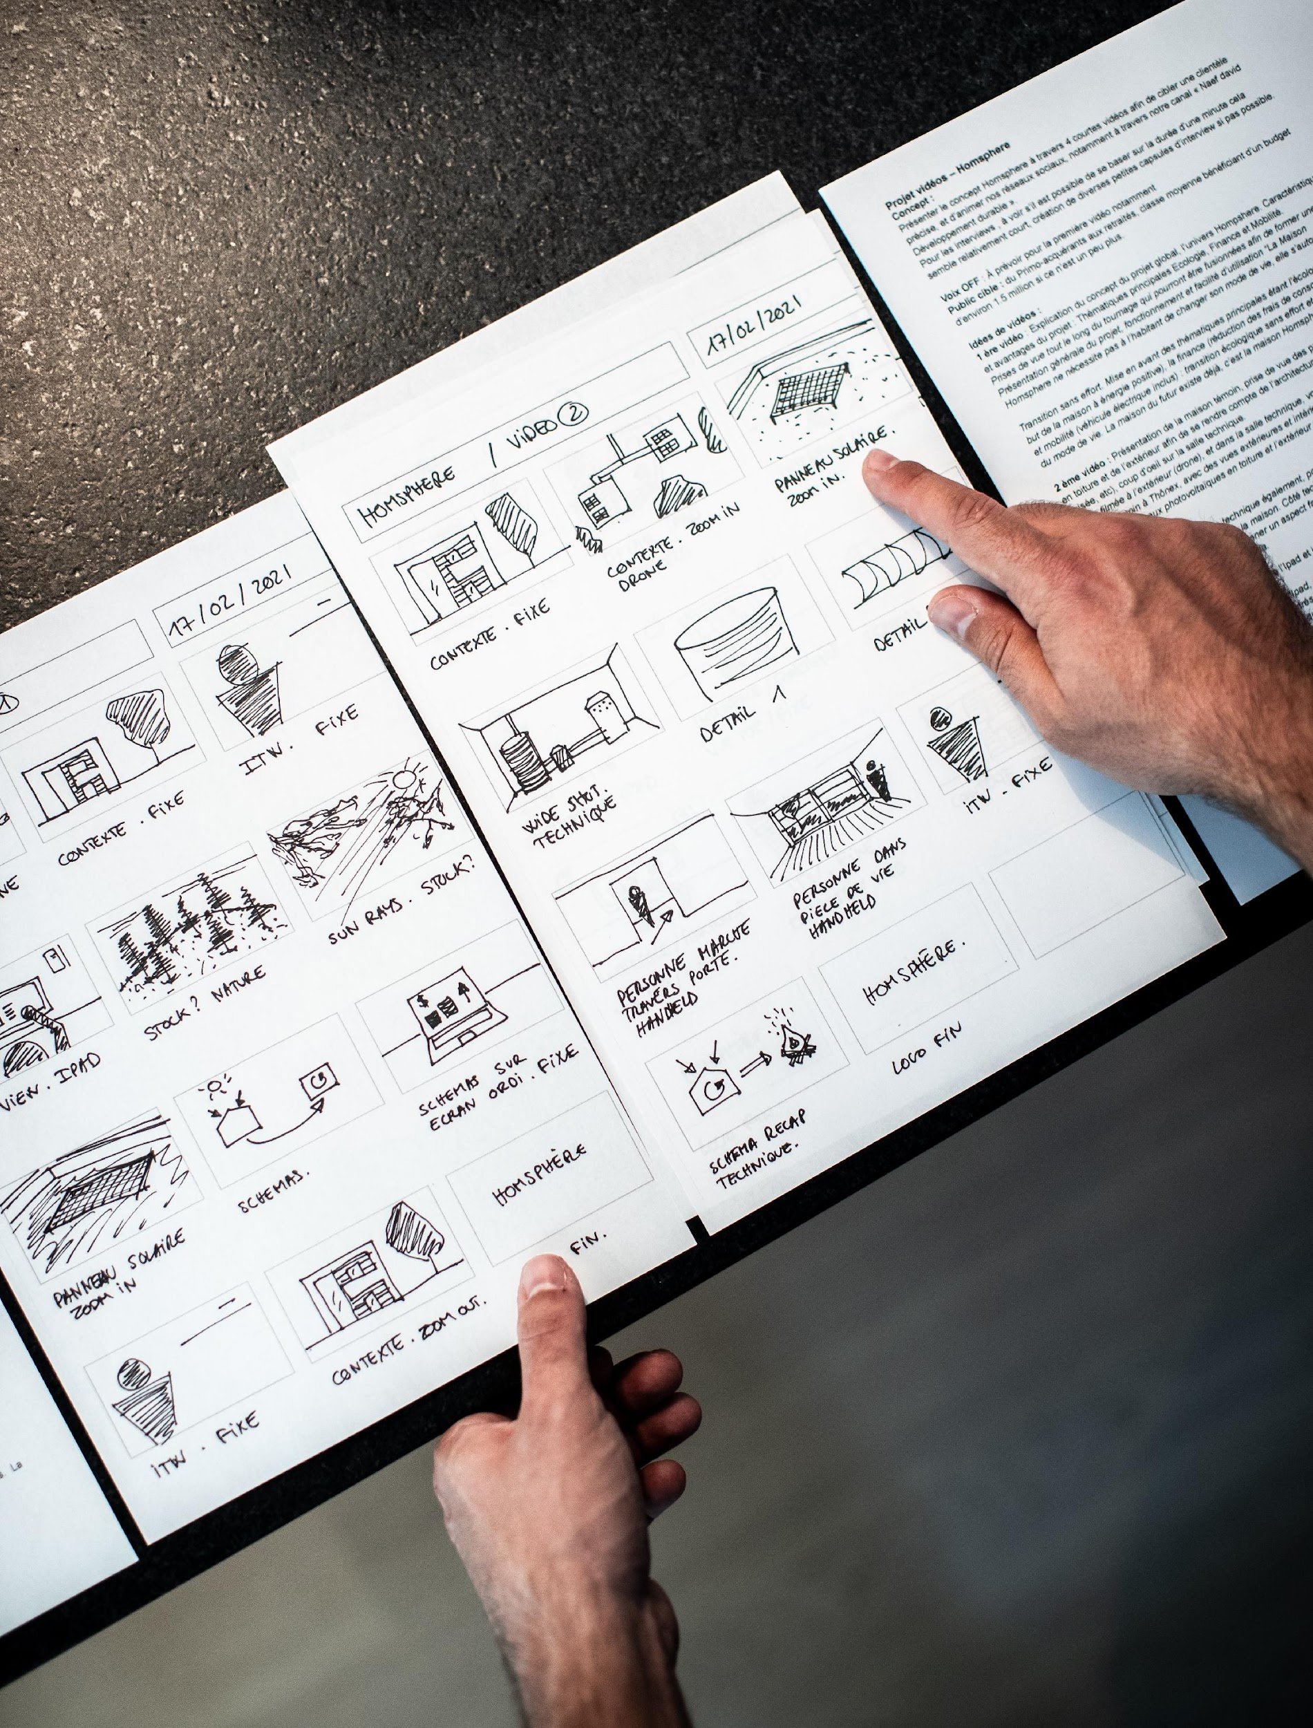
Step 3: Plan/Storyboard
Notes:
The short script and interview questions or a storyboard will not only help you develop the video, it also helps you to know what you need to record a video. Having this clear you can record the video with a better quality.

Slide 11
Step 4: Gather or create images/audio/video
Notes:
Use free image sites that are copyright free such as Pexels or Unsplash.
You could also use free movie editing software such as Movie maker or lightworks

Slide 12
Step 5: Put everything together

Slide 13
Step 6: Publish

Slide 14
Step 7: Feedback and reflection

Slide 15
Unit 2: Smartphone Flim-making

Slide 16
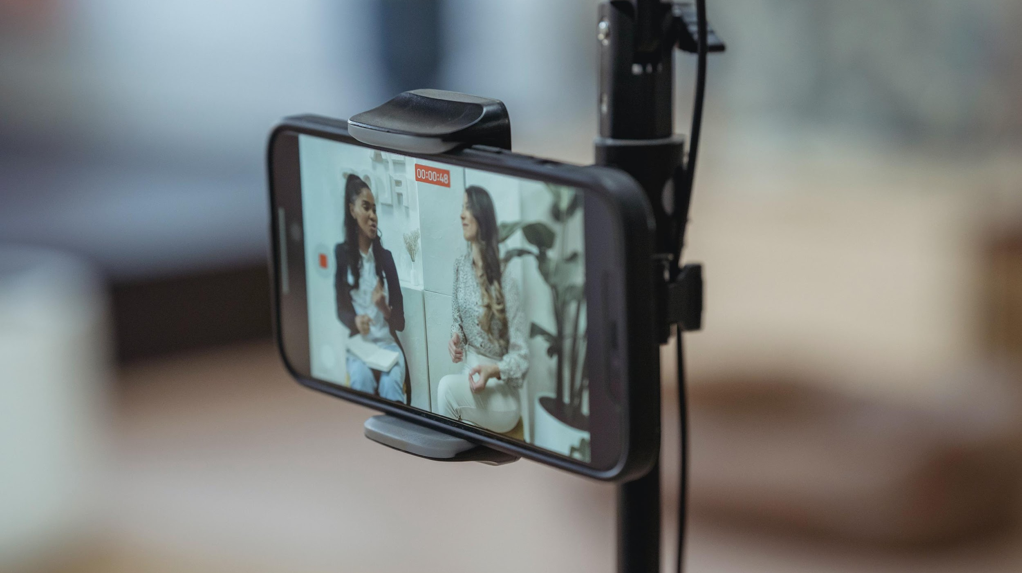
Camera Quality
Notes:
The cameras (back and/or front) of a smartphone are powerful tools capable of generating quality images that, added to the portability of the device and its distribution capacity on the internet, converts the smartphone into a mini video recording studio – that you can work with on the go.
However, your smartphone isn’t just useful for taking impromptu videos and photographs when you are out and about; it can also be used for the production of a video with stable image, controlled light and good quality audio. All smartphones now have the technical characteristics necessary to produce a video with professional appearance.
Recording videos with your smartphone has already become commonplace. The high quality offered by the cameras of most current smartphones means that even the professionals sometimes use their smartphones! The latest innovation included in mobile cameras is the ability to record with 4K quality. However, although we have high quality cameras this will be of little use to us in making our videos if we do not know how to use them correctly.

Slide 17
Lighting
Notes:
Smartphone cameras have small image sensors and low dynamic range. Shooting in dark environments will give you grainy, low-quality footage, so you should try to shoot your video in brightly lit areas. In addition, the auto exposure on mobile phones is typically slow to adjust when changing from one scene to the next, so be cautious of this when moving from dark areas to bright ones. Most cameras offer touch focusing and exposure; use this feature to expose a specific part of a scene or subject. There are also a few LED lights on the market that are small and easy to use.

Slide 18
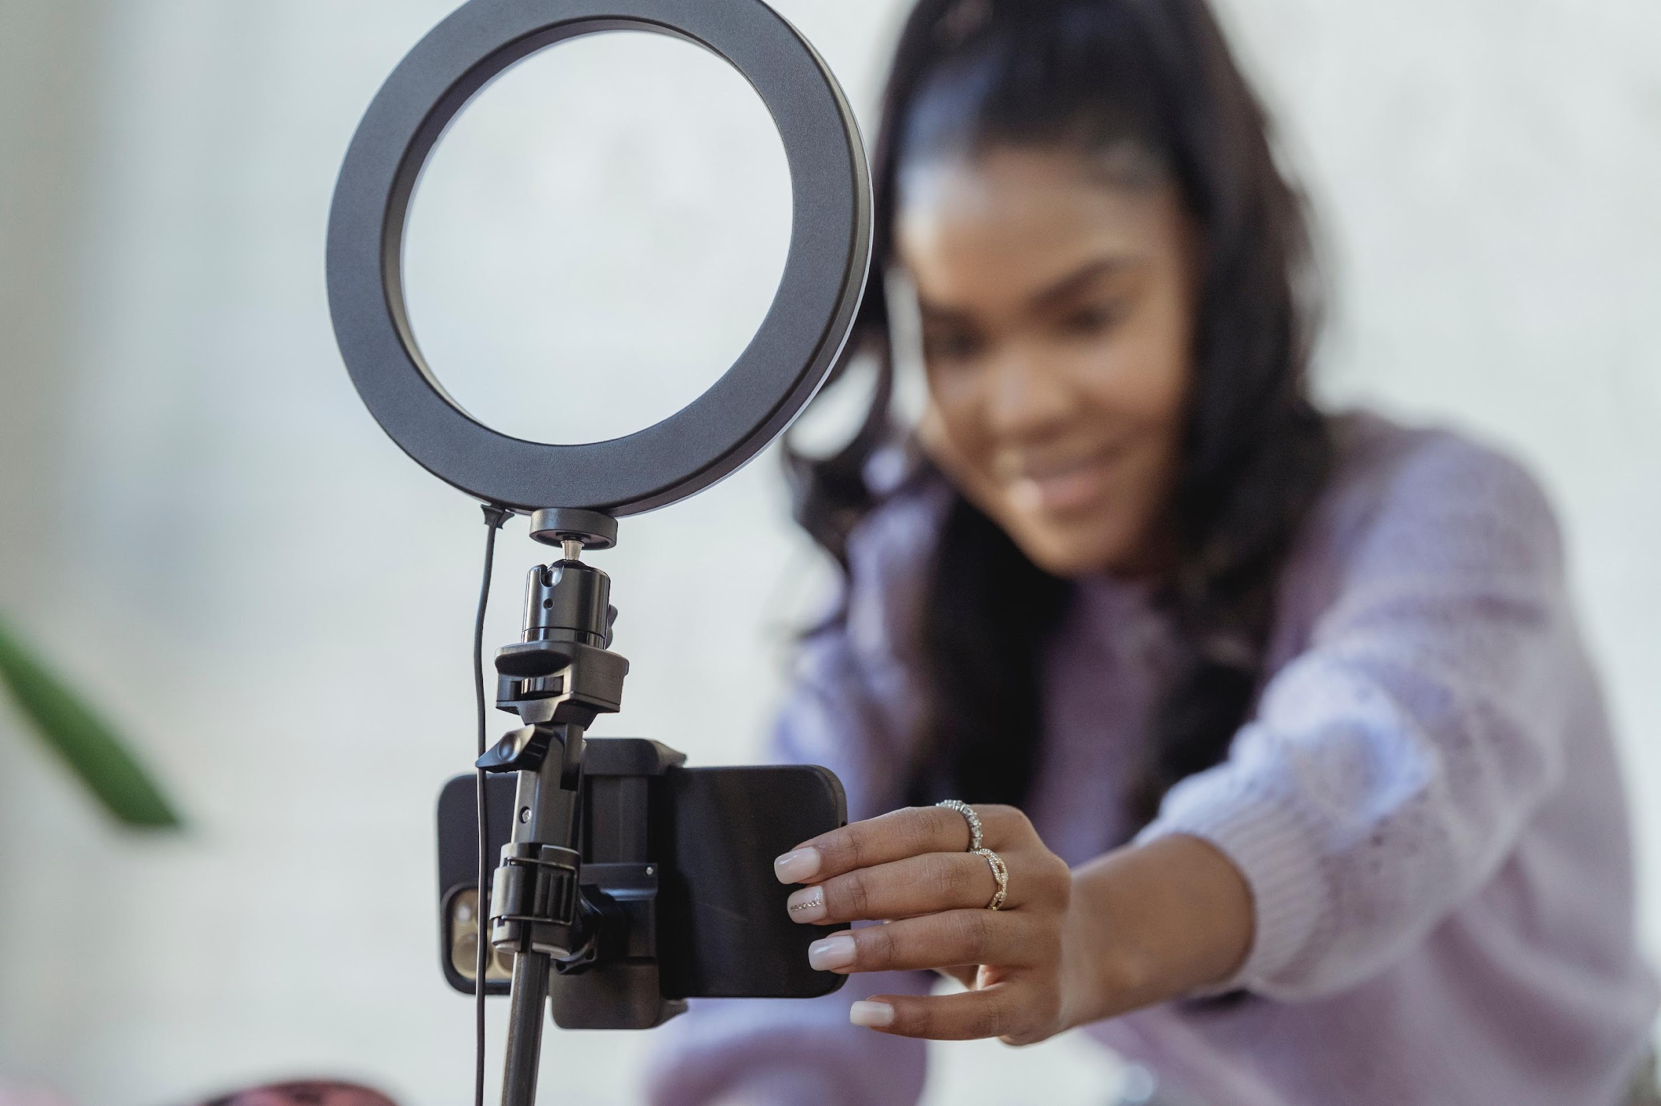
Lighting
Notes:
Why directional lighting is important:
Directional lighting involves the interaction between your subject and your source of light. Understanding how to place your subject (or move around it) to capture its best possible sides will help you take breathtaking photographs with your smartphone. There are three main types of directional lighting:
Front Lighting - Well-lit, even lighting like this is ideal for landscape photography, but don't confuse it with harsh midday light! Front lighting can be used on cloudy days or when the sun is about to rise or set.
Back Lighting - Backlight is often used during the golden hour. Portrait photographers flourish when it comes to this type of light. When the sun is behind your subject, you can create interesting silhouettes or use the sun's rays to create elegant light halos around your subject. The results are cheerful, golden, and visually appealing. Backlighting is used in a variety of photography genres, so make sure you experiment with it as much as possible.
Side Lighting - This involves exposing half of your subject to a source of light, be it artificial or natural. Side lighting creates fascinating shadows, accentuates exposed features, and highlights textures. Still life photographers use this kind of lighting to enhance the natural texture of objects. Portrait photographers often use side lighting in studios to create a sense of mystery.

Slide 19
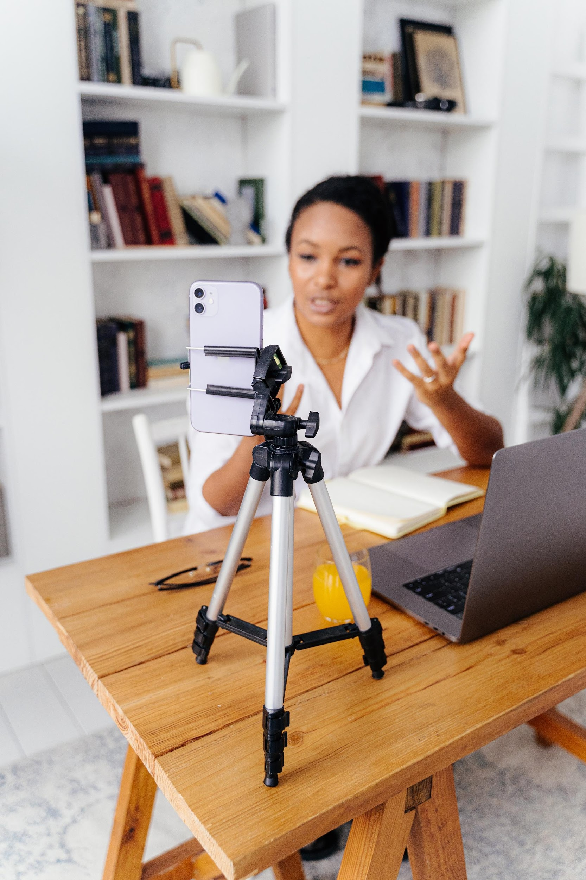
Tripod stand
Notes:
It can be challenging to shoot steady footage with a mobile phone. Smartphones are light and small, making them hard to keep stable. Always shoot using both hands, keeping the device as close to your body as possible. Consider propping the phone or your arms on a fixed structure, like a table or wall, for more stability. And for the steadiest shoots, consider getting a small tripod. Shaky video might be your style or intention, but in most cases, it’s not. Invest in a small support system, like a tripod to lock down those shots. Don’t go overboard with a bulky DSLR tripod, though; keep it light and small so it’s easy to carry around. A tripod can also be used as a pole to capture those high angles, or if you want, to get above the crowd.

Slide 20
Recording
Notes:
3. Exposure and focus
Smartphones and digital cameras will automatically detect and adjust exposure and focus accordingly. It’s great for taking quick snaps, but ideally while recording you’ll want to have more manual control and lock these down so they don’t adjust and leave your footage over-exposed and out of focus.
Simply tap on your subject using your smartphone’s default app to manually lock exposure and focus in your footage. This can be adjusted whilst filming. Most modern digital cameras also offer this tap feature. If not, a ‘half-press’ of the capture button will do this.

Slide 21
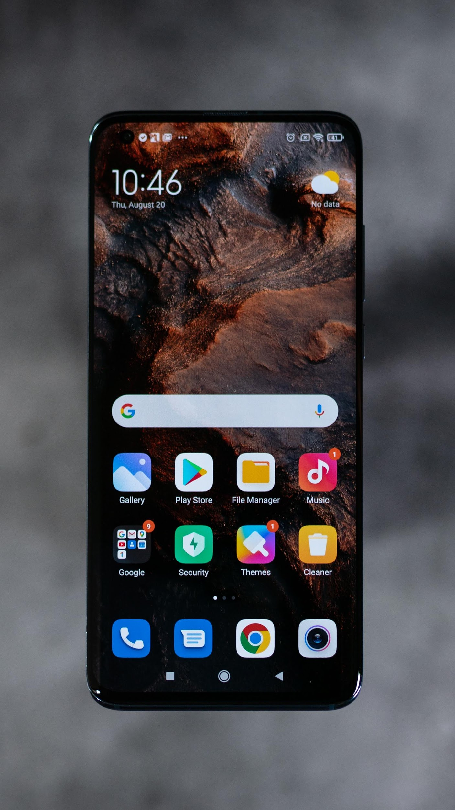

Slide 22
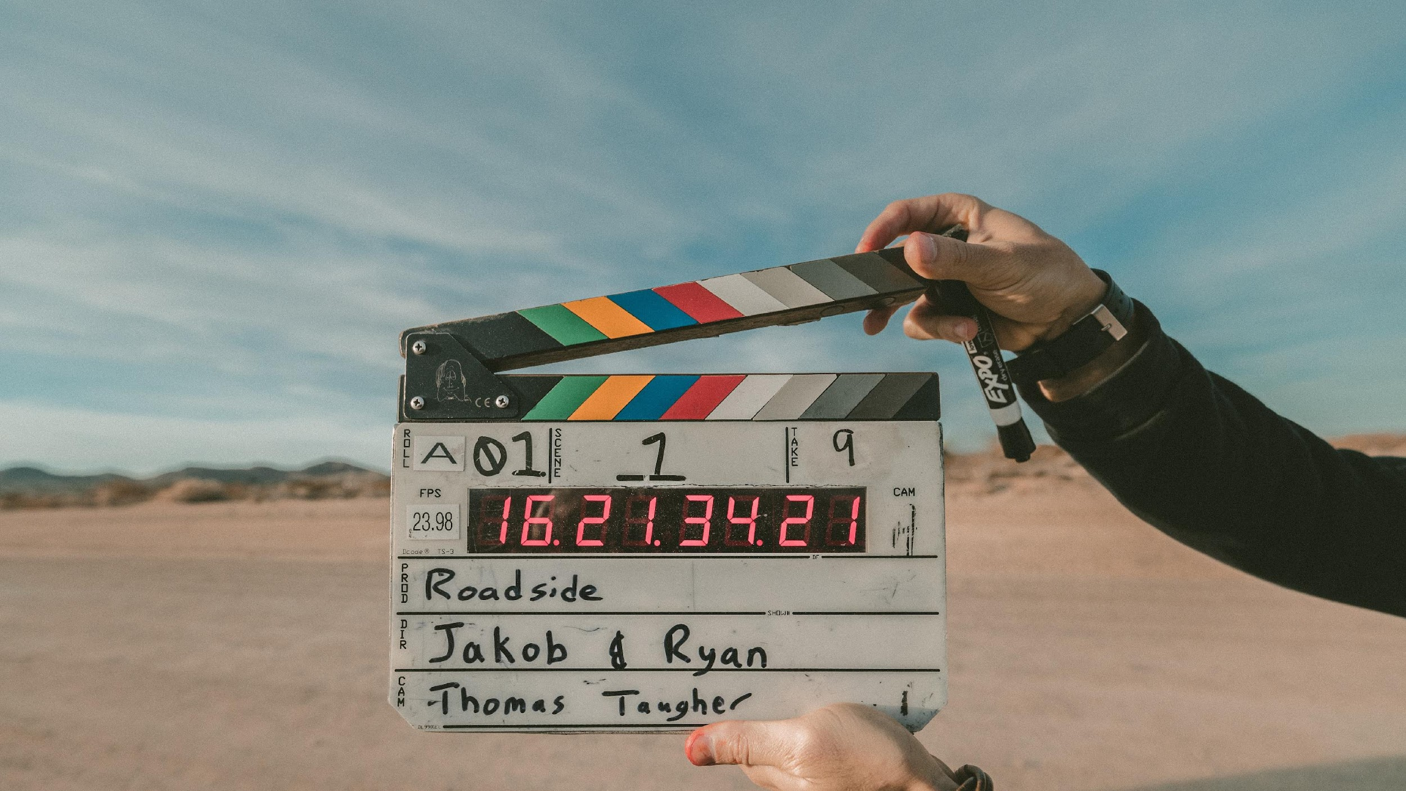
Notes:
Finally, you have to be mindful that in order to get the best performance from your smartphone’s camera, you need practice! The ability to record videos like a professional is now at your fingertips. What are you waiting for?

Slide 23
Unit 3: Introduction to audio production
Notes:
We are going to take a quick look at the topic of the video production on smartphones and why the audio is even more important than the video content – especially in your oral history project

Slide 24
Audio recording
Notes:
In production, it is very common for beginners to neglect how important sound is, in preference of capturing a better-quality image.
As an audience, if we do not have quality sound, we cannot fully immerse ourselves in a story and we lose interest in what we are seeing. The sound is 50% of an audio-visual production and as such, you have to pay attention to the sound when recording your video project.

Slide 25
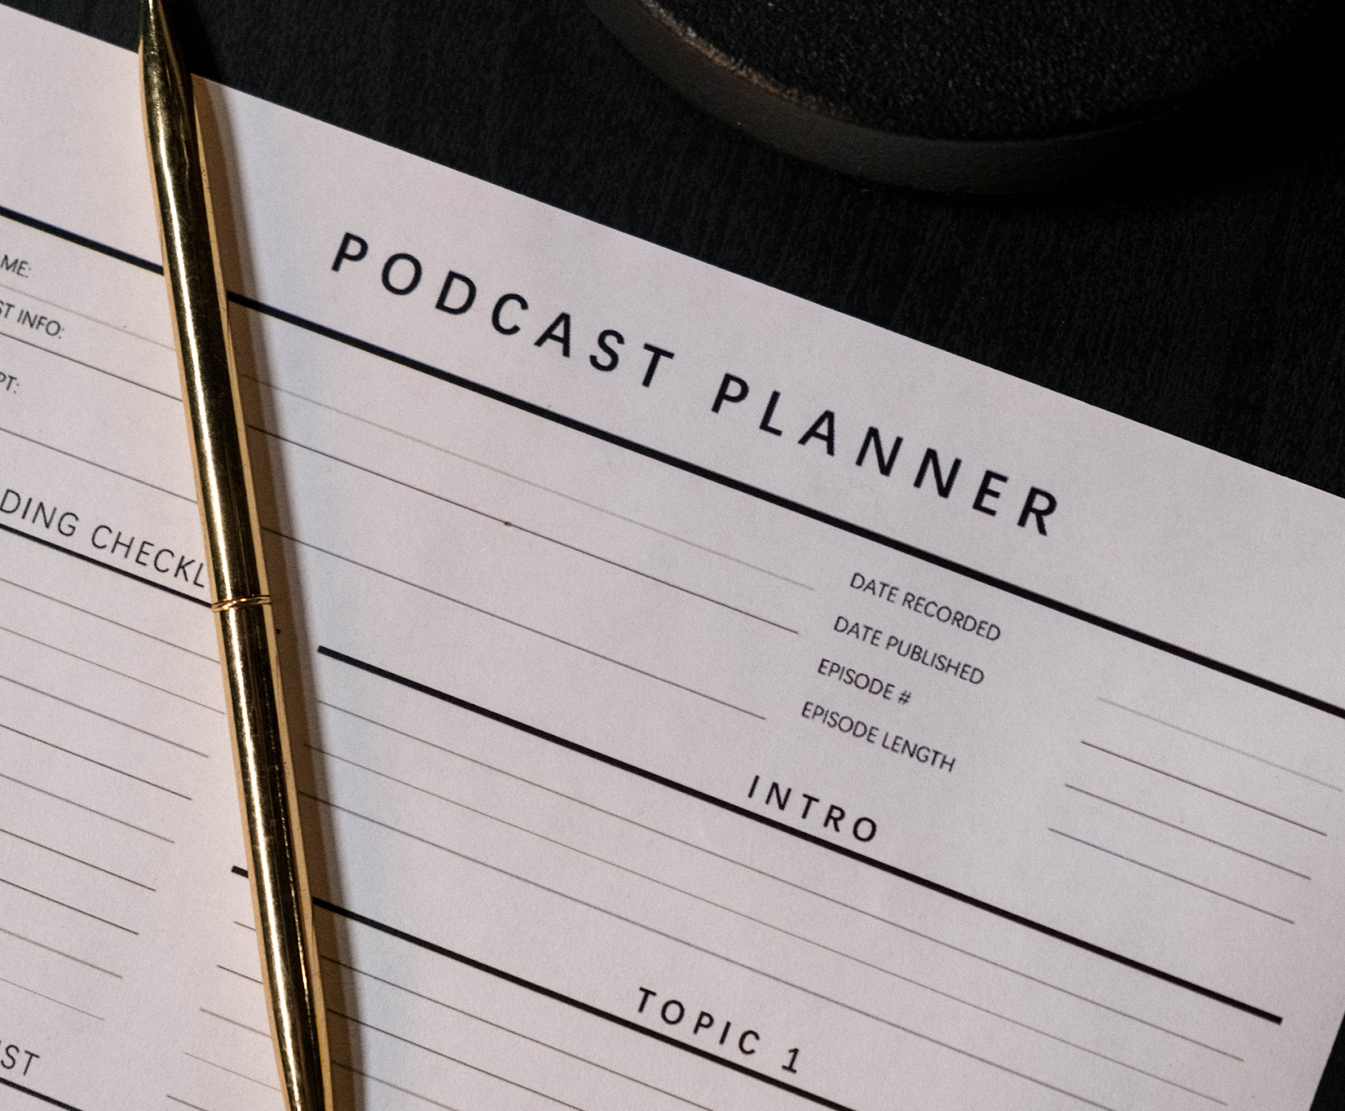
Organisation and Planning
Notes:
In pre-production, while you and your team are planning your video project, you have to think about how the sound will be captured. We have to investigate the site where the recording will take place and locate where to put microphones and recorders. Then we will have to analyze what type of microphones or recorders will be most suitable for each situation.

Slide 26
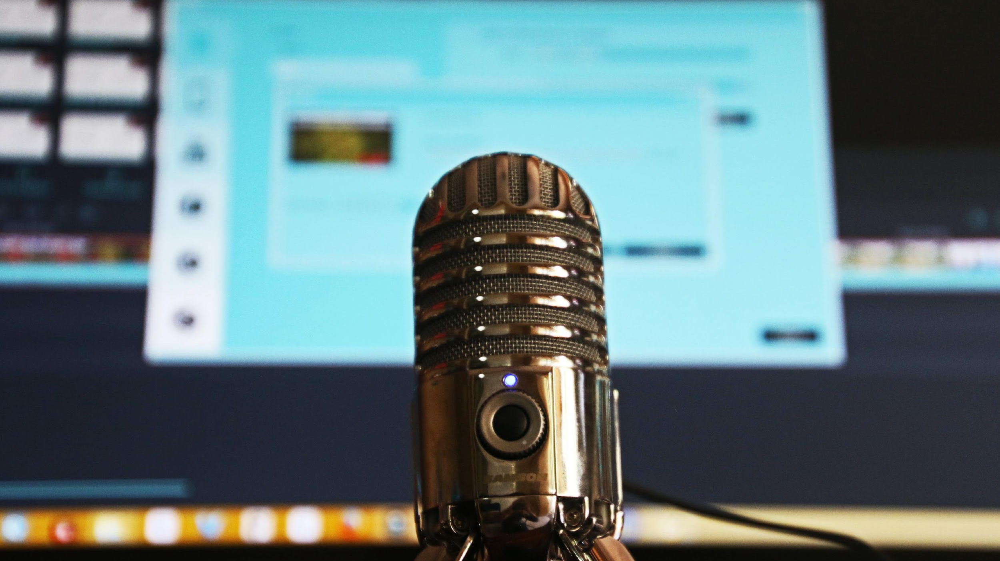
Sound capturing
Notes:
It is very likely that during the recording of your video you will fail to record all of the sounds that you wanted to include in your project. It is nothing to worry about. During post-production, you can produce those sounds and synchronize them to those that you could capture in recording. The audio from the original recording is called direct sound. If you do not have the opportunity to do it yourself, look on the Internet, there are several sound banks, even ones that are free of access.

Slide 27
Write your script

Slide 28
Book your Guests

Slide 29
Record the show

Slide 30
Publishing
Notes:
Which platform are you going to publish your podcast on?
Will you publish on multiple platforms?
Which are they biggest platforms for podcasters today?
Will you need some promotion to get your story out into the world?
Who is your target audience?

Slide 31
Questions?

Slide 32
"The European Commission's support for the production of this publication does not constitute an endorsement of the contents, which reflect the views only of the authors, and the Commission cannot be held responsible for any use which may be made of the information contained therein.” Project Number: 2020-1-FR01-KA227-ADU-095130

