Slide 1
Module 4

Slide 2
Module 4: Editing and Presenting your Story Online

Slide 3
Editing and Presenting your Story Online
Learning Outcomes

Slide 4
On successful completion of this module, adult learners will be able to … | Knowledge | Skills | Attitude
 | Basic knowledge of how to edit stories in a digital format Factual knowledge of how to edit a Podcast using Audacity or similar software Factual knowledge of how to edit a Video using Lightworks or similar software Factual knowledge of how to edit an animation using PowToon or similar software Practical knowledge of how to use equipment and software to present digital stories online Practical knowledge of how to share digital media content online Theoretical knowledge of the most appropriate social media channels for sharing stories online Theoretical knowledge of how to foster and connect with an online audience to share your stories Theoretical knowledge of the impact of presenting digital stories online to share with others Theoretical knowledge of how culture is shared through digital stories when presented in online environments. | Discuss how to edit and present digital stories online Demonstrate how to edit and produce digital media content online Use open-source digital software such as Lightworks and Audacity to edit digital stories Demonstrate how to present stories online in a safe and responsible manner Identify suitable online and social media channels to present your story online Discuss the copyright and licence issues of sharing your story in an online environment | Awareness of the different components involved in editing digital media Willingness to share digital stories in online environments Appreciation of how presenting digital stories online can share culture, identity, and history Appreciation of an individual’s contribution of producing and sharing digital stories

Slide 5
Editing and Presenting your Story Online
Digital Editing

Slide 6
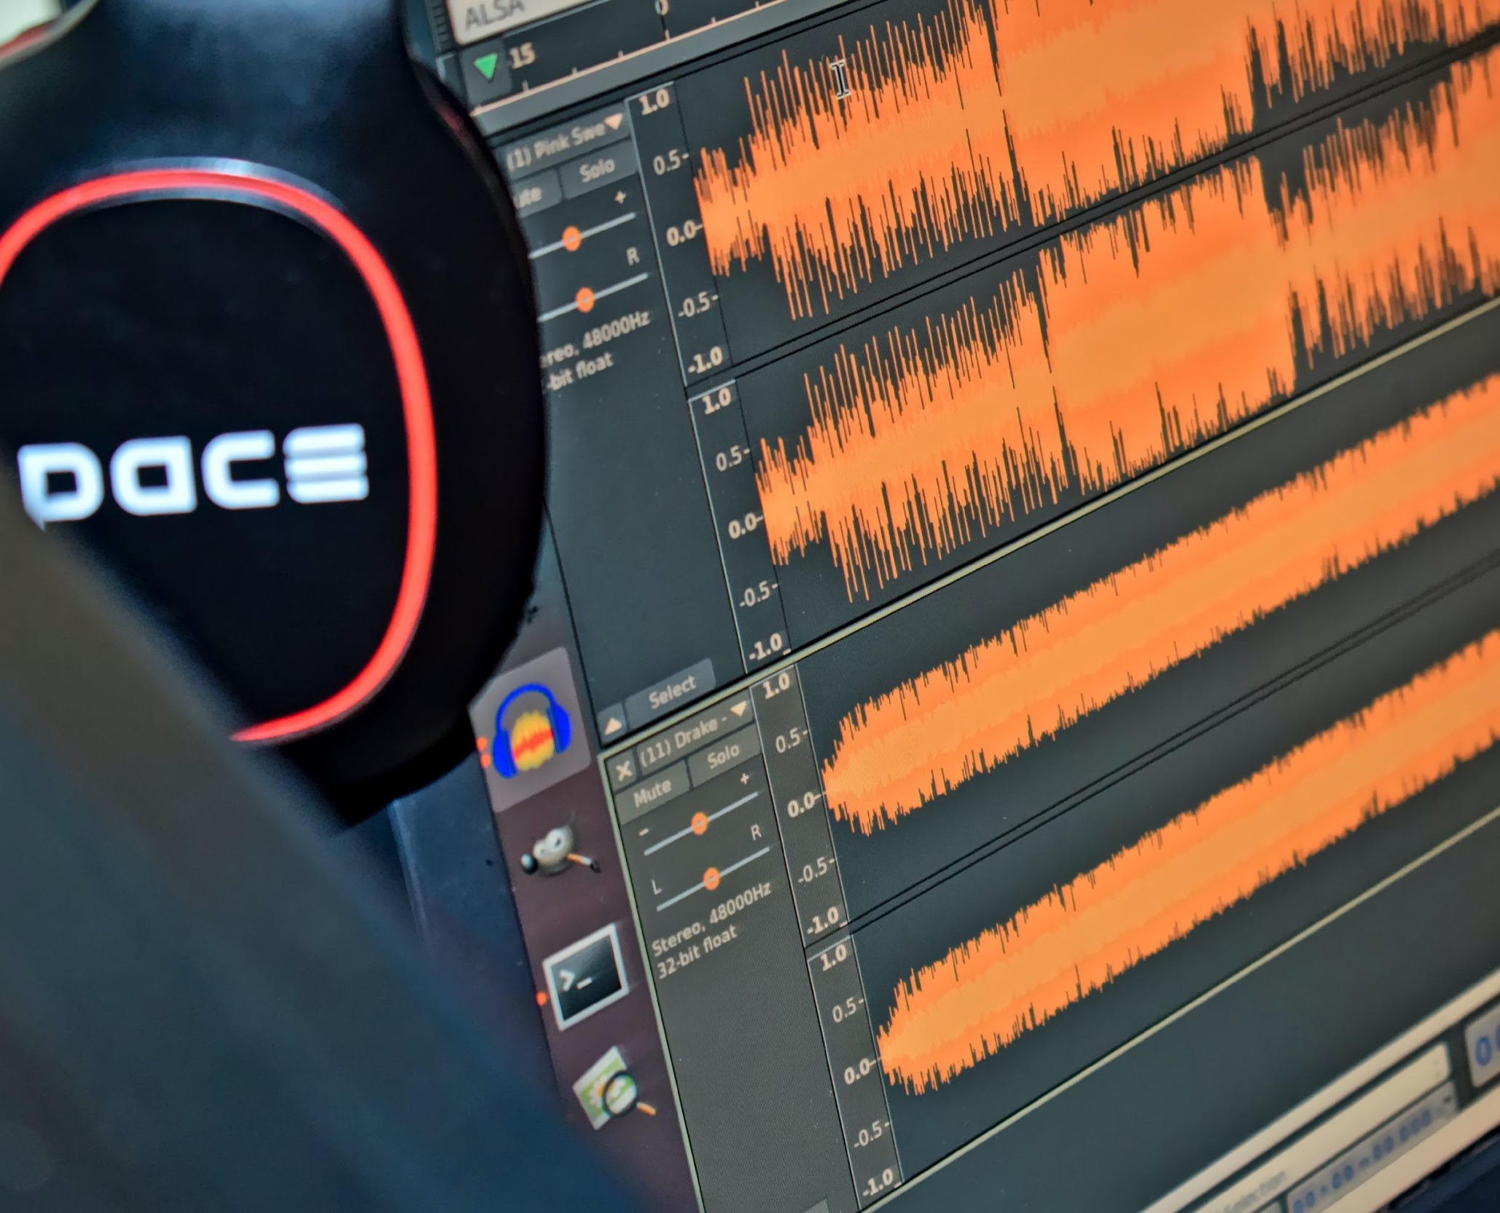
Digital Editing Digital editing is the process of transferring film and audio into a digital editor in order to edit and make changes to your media files. This is where you combine visual and audio parts to create and publish digital content.

Slide 7
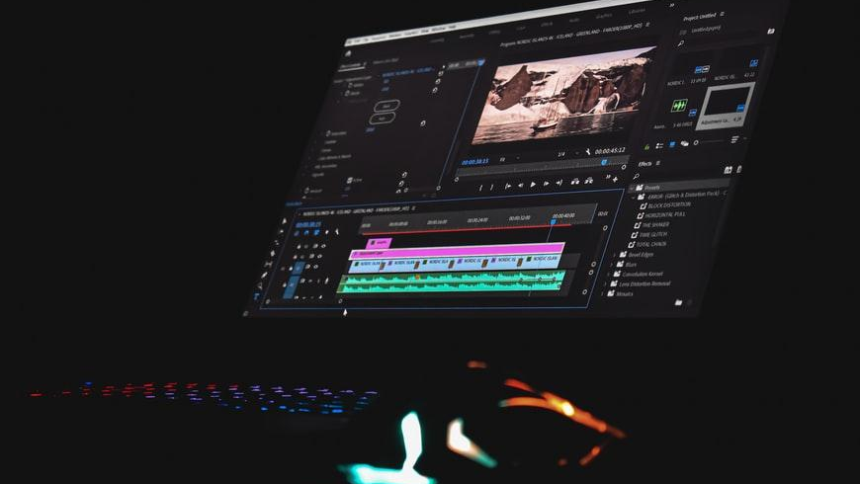
Choosing the right tools Storytellers do not have to use professional tools - sometimes a smartphone is all you need. There are many free open-source tools available online to create and share stories. Mostly, you will need to find a tool that best matches the purpose of your project, your skills, the available resources, and the needs of your target audience.

Slide 8
Editing and Presenting your Story Online
Open Source Software

Slide 9
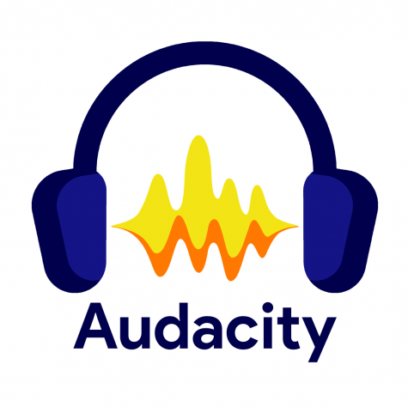
Open Source Audio Editing Software

Slide 10
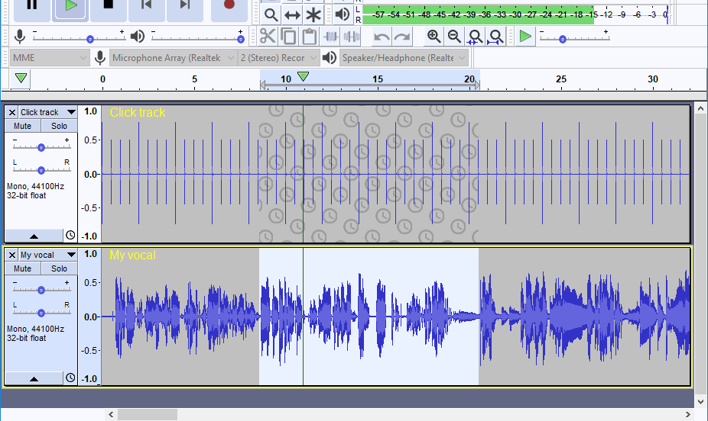
Audacity
Audacity is a free, easy-to-use, multi-track audio editor and recorder for various operating systems.
You can add music, sound effects, audio tracks to your project and create your own digital story.
YouTube Video Tutorial: https://www.youtube.com/watch?v=FiXbfeKA-fk
Free Download here: https://www.audacityteam.org/download/

Slide 11
Recording
Audacity can record live audio through a microphone or mixer, or digitize recordings from other media.
Audacity features
Export / Import
Import, edit, and combine sound files. Export your recordings in many different file formats, including multiple files at once.
Editing
Audacity can record live audio through a microphone or mixer, or digitize recordings from other media.
Effects
Audacity can record live audio through a microphone or mixer, or digitize recordings from other media.

Slide 12
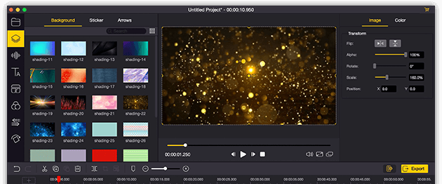
Lightworks is an award-winning and easy-to use video editor with a simple interface that allows you to cut and merge videos, sounds and images. Youtube Video Tutorial: https://www.youtube.com/watch?v=gXfyXAwFfVU Free Download here: https://lightworks.en.softonic.com/download

Slide 13
Editing
Three/four point editing including, Insert, Replace, Fit-to-Fill, backfill, audio levelling, track sync warnings, multiple videos and asymetric trimming.
Lightworks features
Graphic
Filters and LUTs, creative transitions and colour correction will give your video the look you're looking for.
Cloud
You can edit directly from your cloud storage. Just connect, browse and drop clips instantly into your timeline.
Voice over
Record voiceover directly over your playing timeline

Slide 14
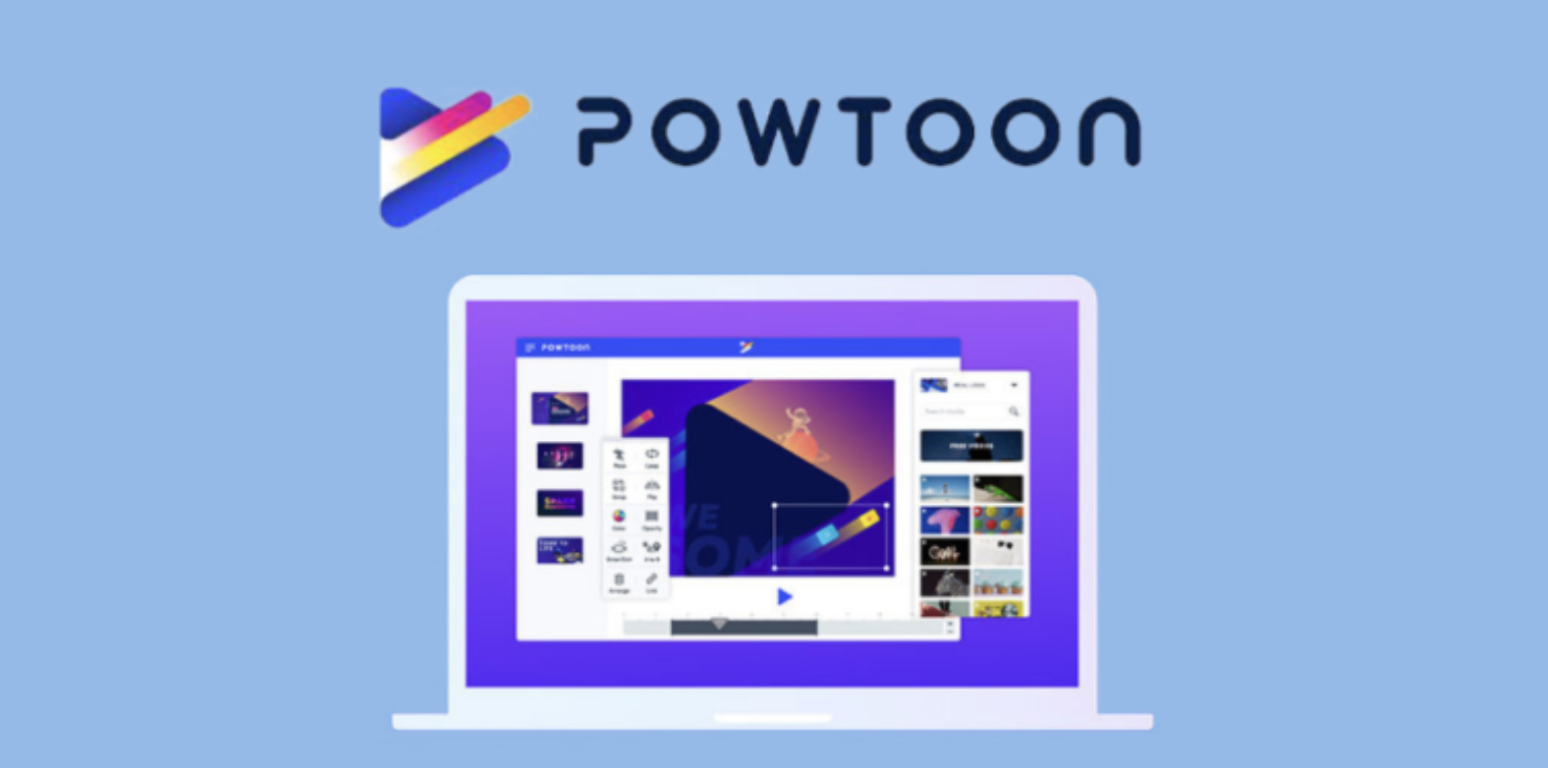
Powtoon is an online free-to use visual communication platform and online video maker designed to create engaging animated videos and presentations with a professional look and feel.
Free log-in:
https://www.powtoon.com/
YouTube Video Tutorial: https://www.youtube.com/watch?v=lEQiZQi-aGY&t=508s

Slide 15
Create
You can create videos and presentations in any style with videos, images and charachters or animations
Powtoon
Features
Manage
You can manage your projects, teams and shared libraries with your trams. Integrations with Microsoft Teams, Photoshop, Canva, PowerPoint, Hibspot & more.
Share
You can share your creations on social and marketing platforms or download your videos.

Slide 16
1. Script. You need to create a script that describes what will happen in every “scene”.
2. Voiceover and Background music. Choose a background track for your music or record a voiceover.
3. Create your slides. Start creating slides according to the script. Each slide represents a scene and an idea as outlined in the script.
4. Populate the slides. Add fun features, such as colors, graphics, background, animation styles, props, images, and characters to your slides.
5. Timing. Adjust elements and voiceover in the timeline.
How to make animation with Powtoon

Slide 17
Editing and Presenting your Story Online
Using Editing Software

Slide 18
Using Editing Software
Make a list of the scenes and audio tracks that will be used in the final film project.
Choose your music, videos and images and store them in a file
Make a copy of all the files and work with the copies

Slide 19
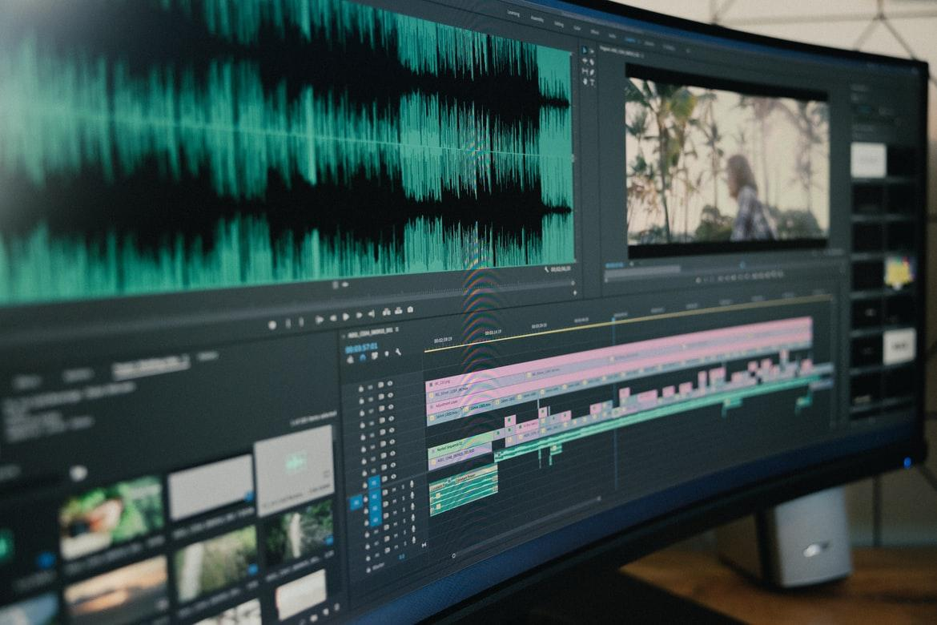
Using Editing Software
When you have downloaded the software programme you will use, you will need to ‘Create a New Project’ on the programme.
Next you will need to import the video and audio files from your ‘Final Cut’ folder.
Remember to import the files in sequence!

Slide 20
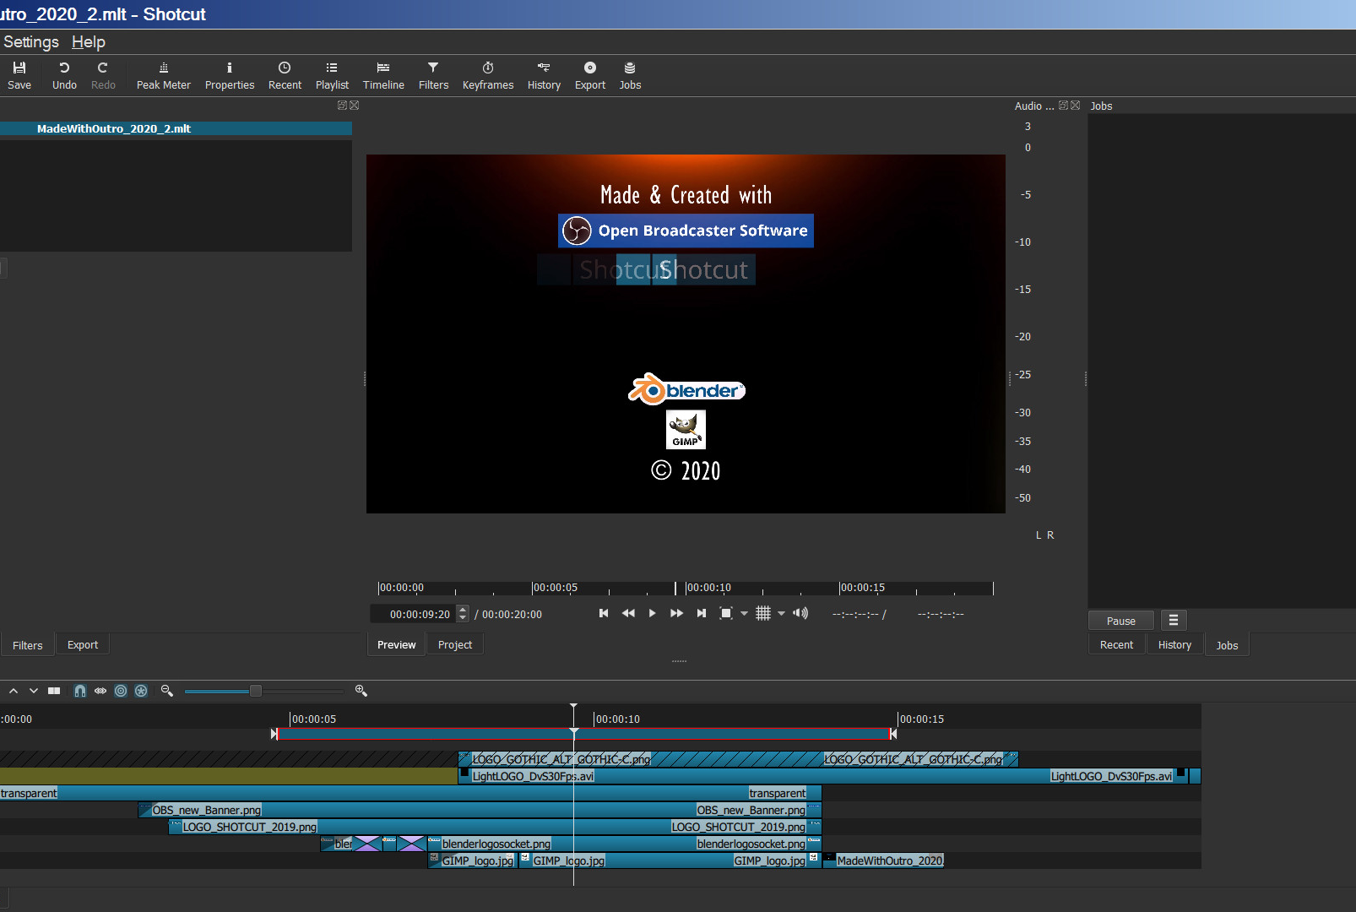
Using Editing Software
The user interface of most editing software and programmes consists of two basic elements:
1) An editing window, where video and audio material is placed along a timeline and edited
2) A preview window, where you can watch the video.

Slide 21
Using Editing Software
Effects
When using your software, you can cut, click and drag and reorder video and audio tracks along the timeline.
But gradual shifts, called transitions, are sometimes more appropriate.
If you are editing multiple scenes, you can add ‘transitions’ between the scenes.
The most common transitions on film and TV are ‘Cross Dissolve’ (slow fade between two clips) and transition to black.

Slide 22
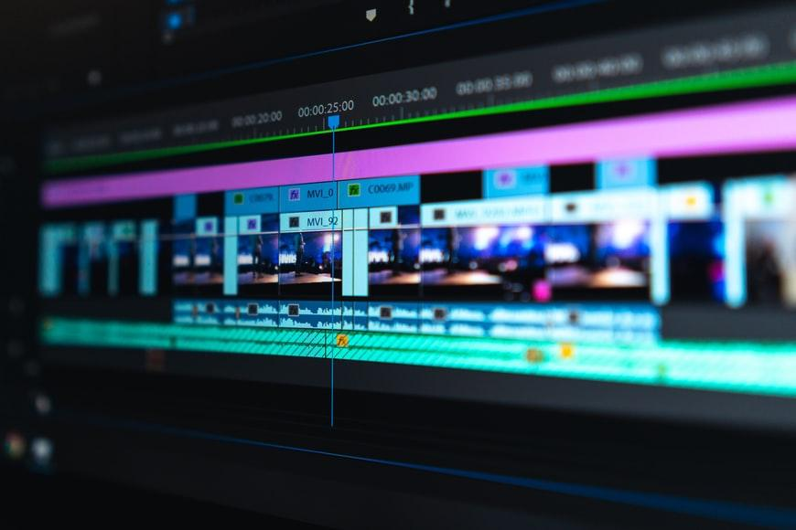
Using Editing Software
Jump cut
A “jump cut” is when the sound and picture change at the same time.
In film this is the equivalent of a new paragraph or chapter in a book.
However, if you want to keep the story going smoothly, let the sound from the previous scene carry on for a few seconds while the scene appears on screen, or let the sound from the new scene begin a few seconds before showing it.
A clean or jump cut between clips is the most common way of putting different shots together.

Slide 23
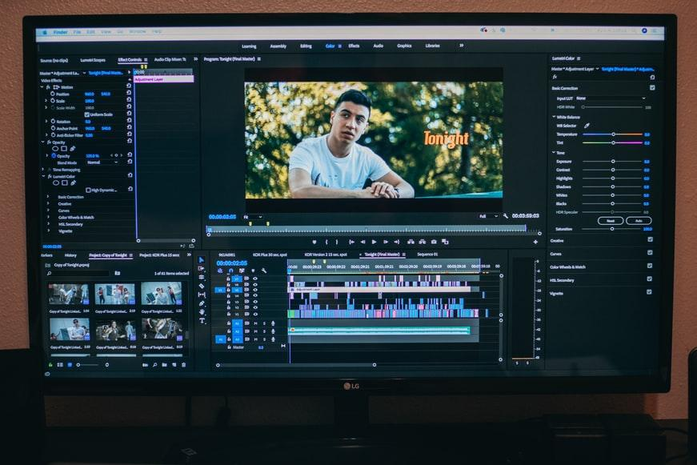
Using Editing Software
Final Steps
The first step to complete in the editing process, is to review all of the footage and sound files that your film crew has captured.
It is important to label and store all files correctly, so that you can find all the footage you need.

Slide 24
Editing and Presenting your Story Online
How to edit podcasts in Audacity

Slide 25
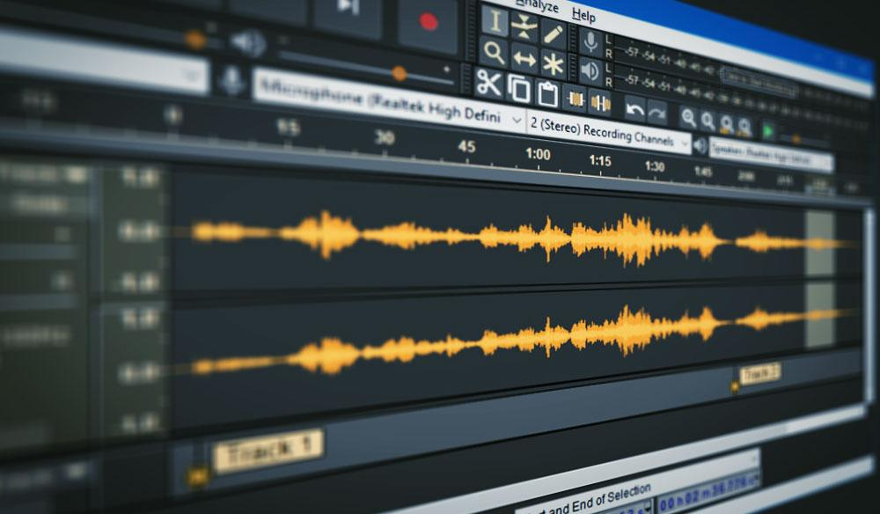
How to edit podcasts in Audacity
Getting started
Import the audio you have previously recorded.
Use Track One for your main audio track (e.g. narration, interview, discussion)
Place the audio material in sequence (e.g. intro narration, interview, outro).
Leave an empty track underneath for editing
Add music, sound effects or secondary audio later in the editing process

Slide 26
How to edit podcasts in Audacity
Touch-ups
(Re)listen to your material
Decide what sections you want to keep or delete and if you want to change the order
Use the noise reduction tool to remove unwanted noises
Delete unwanted material
Move everything into the right order

Slide 27
How to edit podcasts in Audacity
Improve audio quality
Normalise the levels, choosing -2.0 for your peak amplitude
Amplify any areas that remain too quiet
Use the compressor tool to make parts sound louder or softer
Use the equalisation tool to manipulate the frequencies to make a voice deeper or less nasal
Import your music or sound effects and move them to the area you wish them to be
Export your final product as an MP3

Slide 28
Editing and Presenting your Story Online
How to share digital media content online

Slide 29
Video-sharing sites

Slide 30
YouTube
Key Features:
World’s most popular video platform.
Supports most video file formats.
YouTube´s own Audio Library: you can add music and sound effects to your creation after it’s uploaded
End screens: you can add an end screen showcasing additional videos, playlists, links and subscribe buttons.
Cards: you can add cards that point viewers to a specific link and show customized images, titles, and calls to action, depending on the card type.
Comment section to connect with audience

Slide 31
YouTube
How to boost your visibility on Youtube:
Add an SEO friendly title so that it’s more easily discoverable via search engines.
Add a description of the video so people know what your content is about before watching it.
Add tags, which act as tools to help the discovery of your video

Slide 32
YouTube
Create YouTube Stories
YouTube Stories are short, mobile-only videos that allow you to connect with your audience more casually, on the go.
Sign in to YouTube on mobile.
Tap the create icon, then Add to your story. If you don't see the Story option, your device is not compatible with Stories currently.
Tap the capture button to take a photo, or hold it down to record a video.
Add effects like filters , stickers , and text . ...
Tap Post.

Slide 33
Vimeo
Key features:
Easy-to-use platform
Free video-hosting with no ads
You can either create videos or host your own videos
You can create from thousands of pre-built templates
Unlimited screen-recordings

Slide 34
Vimeo
Additional features:
You can customize your videos with animated stickers, styles, filters, and layouts or add your own logo.
Video Library: you can organize, share, and find the videos that help you work smarter.
Vimeo’s live streaming: you can go live” to broadcast your stream audience, wherever they are.
Custom integrations with Final Cut Pro, Adobe, Dropbox, and Google Drive.
You can add time-coded notes and respond to comments right inside the video from any device.
Share, embed, and download — all from the same platform.

Slide 35
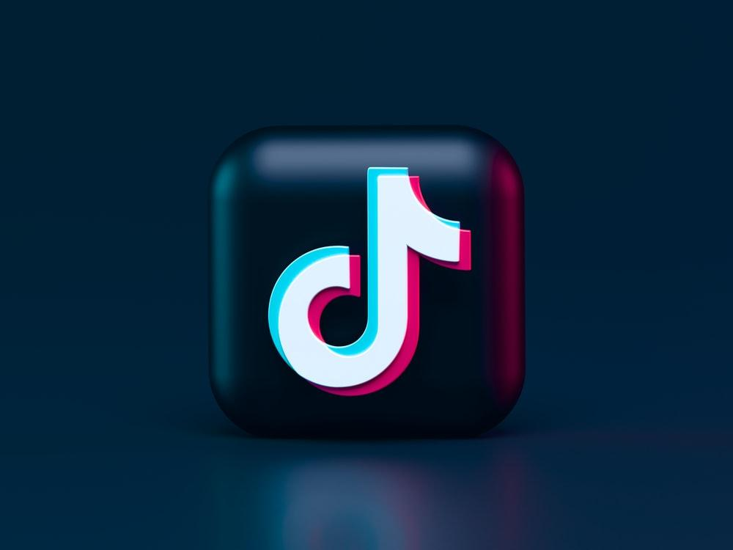
Where to share your digital content
Facebook is the world´s largest content platform for all content types, including text, images, and video. Creating strong stories on Facebook can encourage people to follow you elsewhere.
Instagram is a visual inspiration platform and the best way to inspire others through the power of visual storytelling. On Instagram, the best brand storytelling involves telling micro-stories to give customers a behind-the-scenes look at your business.
TikTok’s short video platform makes it a natural fit for narrative-driven branded content. Through the storytelling frameworks, you can empower your customers and audience to become the center of your story.
Twitter allows you to use multiple photos in a Tweet to create a narrative arc. You can collect and curate multiple Tweets so you can tell a story around a topic or conversation that's relevant to your followers.
SOCIAL MEDIA CHANNELS

Slide 36
Editing and Presenting your Story Online
How to share your stories safely

Slide 37
How to share your stories safely
Don't use inappropriate content
Check if you have permission when choosing music or images

Slide 38
How to share your stories safely
1. What are examples of inappropriate content?
Content promoting hate based on race, religion, disability, sexual preference, etc.
Content promoting violent extremism
Sexually explicit content
Real or simulated violence
Content advocating unsafe behaviour, such as self-harm or eating disorders

Slide 39
How to share your stories safely
2. What is Copyright?
Copyrights protect "original works of authorship." A copyright protects the owner of one kind of intellectual property (creations of the mind).
Copyright plays an important role in digital storytelling. You need to be aware of the law so you know what kind of images, sounds, and other media you can include in your film projects without infringing the copyright of others.

Slide 40
How to share your stories safely
Where to find free to use images:
Unsplash
https://unsplash.com/
Pixabay
https://pixabay.com/
Freepik
https://www.freepik.com/
Where to find free to use music:
Dig CC Mixter:
http://dig.ccmixter.org/

Slide 41
How to share your stories safely
Property rights on social media:
Social media do not own the work that has been posted on their site, the copyright is kept by the owner.
When you post on the site, you sign an agreement that gives the site a license to use your work for a variety of purposes.

Slide 42
Editing and Presenting your Story Online
The power of digital storytelling

Slide 43
The power of digital storytelling
Technology supports new ways of telling stories
Digital storytelling is the old act of storytelling but using digital media, introducing elements of images, audio, video and interactivity with the more traditional text or narrative.
Combines visual and spoken communication
Brings personal experiences to a wider audience
Provides welcome invitation to discovery

Slide 44
The power of digital storytelling
How to connect with your audience
Emotional connection is what makes a story memorable and engaging. In order to engage and connect with your audience, stories must:
be personal
be short and concise
use readily-available source materials
include universal story elements
involve collaboration at a variety of levels (allow members to write comments)

Slide 45
The power of digital storytelling
Why is Storytelling important?
provides a forum for people
helps foster a sense of connection to society or local community
provides social opportunities for people who want to share their personal experiences
helps share culture, identity, and history

Slide 46
The power of digital storytelling
Sharing cultural heritage through digital sories
Stories about cultural heritage are very effective in creating powerful experiences and a sense of psychological proximity.
They trigger our own personal memories, emotions and experiences
They generate empathy
They foster our engagement

Slide 47
The power of digital storytelling
Stories allow us to:
make sense of the world
learn and broaden our knowledge
reflect and change our behaviour
empathise and connect with each other
keep cultures alive

Slide 48
"The European Commission's support for the production of this publication does not constitute an endorsement of the contents, which reflect the views only of the authors, and the Commission cannot be held responsible for any use which may be made of the information contained therein.” Project Number: 2020-1-FR01-KA227-ADU-095130

