Slide 2
Module 1
Introduction to African. Storytelling and Stories

Slide 3
Module 1 Introduction to African. storytelling and stories
Learning Outcomes

Slide 4
On successful completion of this module, adult learners will be able to … | Knowledge | Skills | Attitude
 | Basic knowledge of the background of African storytelling | Discuss the importance of storytelling to preserve culture | Openness to learn about the cultural significance of African storytelling
 | Basic knowledge of African stories | Describe the role of the Griot in African storytelling | Willingness to reflect the social values of African culture to understand generations of histories and experiences.
 | Basic knowledge of a Griot as a storyteller, teacher, and advisor | Identify elements and characteristics of African storytelling | Appreciation of the communal participatory experience of African storytelling and how it contributes to culture, identity, and rationale.

Slide 5
On successful completion of this module, adult learners will be able to … | Knowledge | Skills | Attitude
 | Practical knowledge about the importance and impact of the oral tradition of storytelling | Identify various rituals of storytelling
 | Practical knowledge about the key elements of African storytelling | Recognise the geographical, societal and cultural influences on African stories
 | Factual knowledge about the types of stories shaped by African culture | Determine how storytelling serves many purposes such as

Slide 6
On successful completion of this module, adult learners will be able to … | Knowledge | Skills | Attitude
 | Factual knowledge of the role of repetition, rhythm and music in African storytelling | teaching morals, maintaining cultural values, methods of survival, acts of worship, etc.
 | Theoretical knowledge about African fables, folktales, and genealogies, etc. | Research African stories
 | Theoretical knowledge about the various forms of African storytelling | Recount one African story and find a story in a European setting that has a similar moral/teaching

Slide 7
On successful completion of this module, adult learners will be able to … | Knowledge | Skills | Attitude
 | Theoretical knowledge of the importance of storytelling and stories as a foundation of identity and culture | Practice African storytelling using traditional performance techniques

Slide 8
Unit 1
African Storytelling

Slide 9
What is
Storytelling?

Slide 10
Storytelling is a method of recording and expressing feelings, attitudes, and responses of one’s lived experiences and environment.
The function of storytelling has been identified as mediating and transmitting knowledge and information across generations, informing younger generations about culture, worldviews, morals and expectations, norms and values.
(Tuwe, 2015)

Slide 11
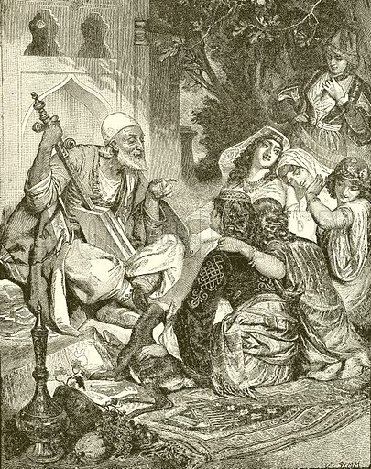
Storytelling is the act of retelling a story or narrative to one or more listeners using one's voice and gestures. It is not the same as reciting a piece from memory or reading a story aloud.
A series of mental metaphors and images associated with words are created and generated by the storyteller.
This means that storytelling can take the form of songs, music, dances, plays, dramas and poetry. Sung stories may be accompanied by musical accompaniment on a specific instrument.
(Yale National Initiative, 2008)

Slide 12
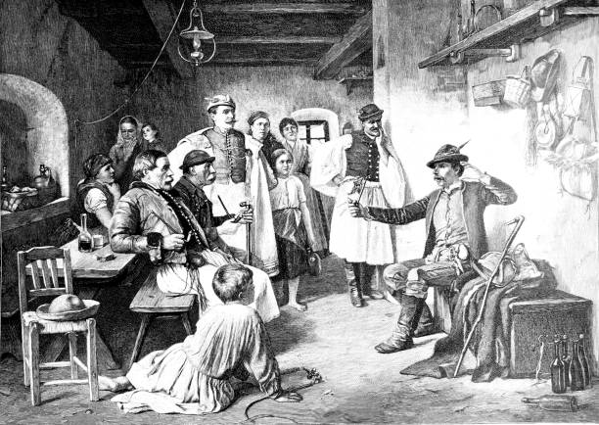
Every human culture on the planet appears to tell stories as a means of making sense of the world. Storytelling traditions vary around the world, but many things remain consistent, such as oral narration, moral teachings, gestures and repetition.

Slide 13
What is
African Storytelling?

Slide 14
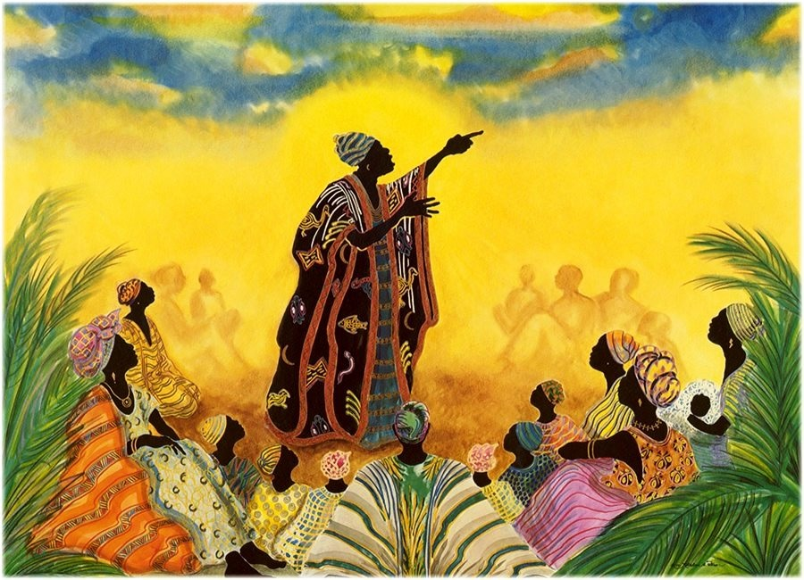
Africans have traditionally valued good stories and vibrant storytellers because they are rooted in oral cultures and traditions.
Although there are ancient writing traditions on the African continent, most Africans today, as in the past, are primarily speaking peoples, and their art forms and stories are told orally rather than in writing.

Slide 15
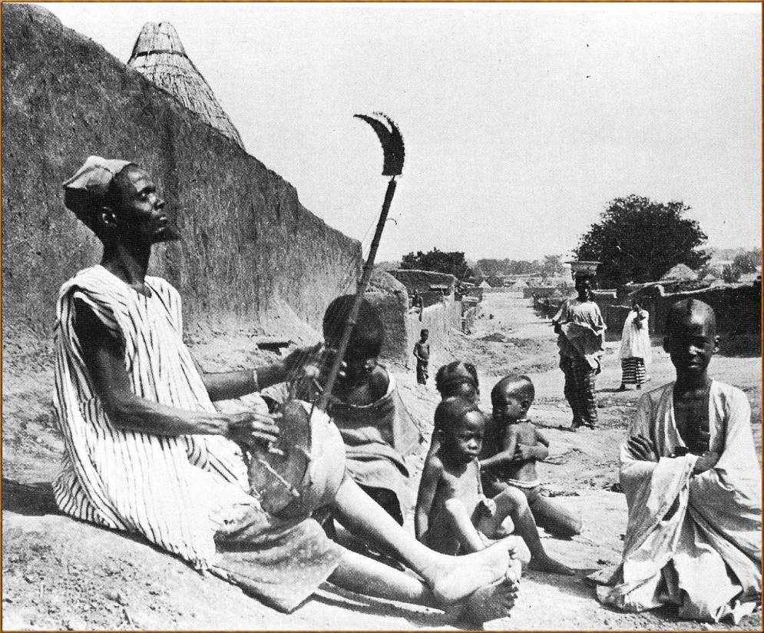
Storytelling has long been used in African culture to pass down traditions, codes, and values of acceptable behavior, as well as to uphold and preserve social order.
Before writing and reading was invented, Africans used storytelling to preserve their history, traditional culture, and ritual ceremonies.
African storytelling is one of the oldest traditions in African culture, spanning the entire continent.

Slide 16
African Concept of Ubuntu

Slide 17
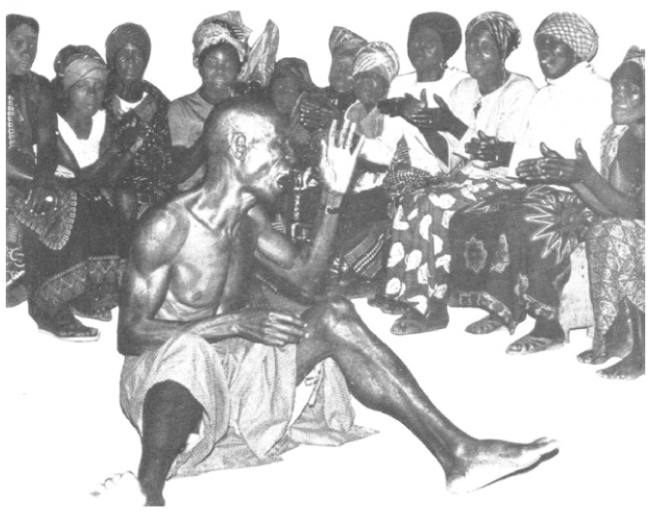
Traditional stories about African people have been woven from the substance of human experience, including struggles with the land and the elements, movement and migration, wars between kingdoms, conflicts over pastures and waterholes, grappling with the mysteries of existence, and life and death.
African stories reflect human-to-human, man-to-woman, and human-to-animal relationships. The African concept of "Ubuntu" venerates this. "I am what I am because of you," says Ubuntu. The entire concept revolves around people or humanity.
These stories explain natural phenomena, teach morality, give Africans a sense of identity, and are both entertaining and instructive.
The animal trickster stories are the most popular among folktales because they feature an animal trickster who has human habits, beliefs, and weaknesses. These stories instill moral values in the tribe or community's members.
(Yale National Initiative, 2008)

Slide 18
The Uniqueness of African Storytelling

Slide 19
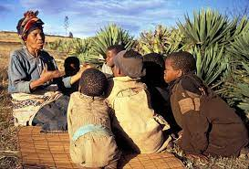
The distinctiveness of African storytelling is enshrined in its ability to provide entertainment, satisfy the curiosities of the African people, and teach and communicate the important moral lessons about everyday life.
Language repetition, rhythm and gesture are all important aspects of African oral storytelling. Words, phrases, gestures, and verses or stanzas are all repeated by storytellers. The use of repetition techniques facilitates understanding and recall of stories from memory.
When the audience is familiar with the stories, they actively participate in learning about important aspects of their culture.
Storytelling in Africa has been demonstrated in a variety of ways and has served a variety of purposes. Many children value storytelling because elementary school students are frequently required to tell stories to their classes as part of the curriculum.
(Tuwe, 2015)

Slide 20
African Storytelling: A Communal Participatory Experience

Slide 21
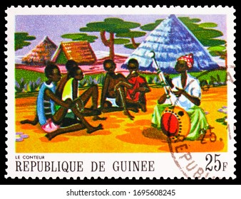
Oral African storytelling is essentially a communal participatory experience and phenomena. It is a shared communal event where people congregate together, listening and participating in accounts and stories of past deeds, beliefs, wisdom, counsel, morals, taboos, and myths.
(Tuwe, 2015)

Slide 22
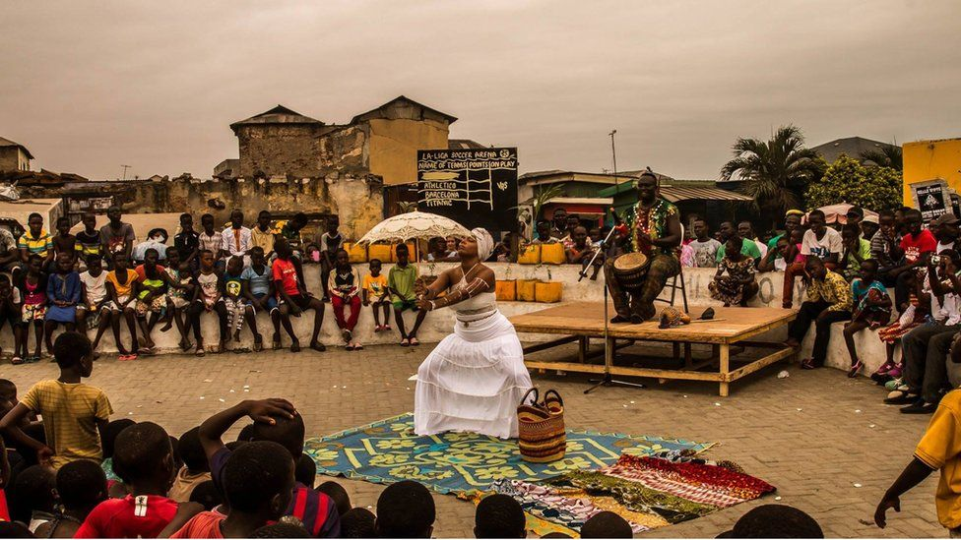
In most cases, African storytelling takes place in a setting where the storyteller and the audience interact, with both parties having rights and obligations. This is analogous to the modern western focus group setup. In most traditional African societies, everyone takes part in formal and informal storytelling as an interactive oral performance. Participation in such activities is an essential part of traditional African communal life, and basic training in a specific culture's oral arts and skills is an essential part of children's traditional indigenous education and values.

Slide 23
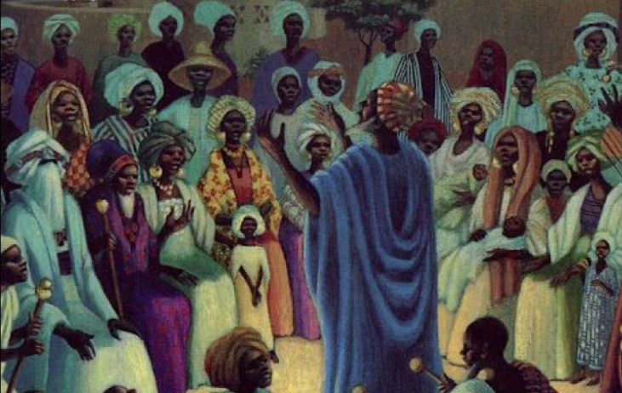
Many accomplished storytellers in these African cultures are respected community members who have mastered many complex verbal uses of proverbs and parables, musical and memory skills after years of communal-traditional training.

Slide 24
Unit 2
African stories

Slide 25
Structure of African Stories

Slide 26
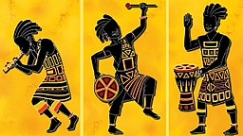
Most stories in an African setting are divided into three sections: the introduction, the body of text section and the conclusion.
After engaging the audience's participation, the storyteller sets the scene by introducing the characters and defining the conflict with various techniques and gestures.
In Zimbabwe, for example, the audience participates in a true dramatic play by singing, dancing, and rhythmically shouting in response to the storyteller. In terms of style, the storyteller decides, and the audience responds accordingly.
The storyteller employs a vibrant language that is rich in images and symbols. Many of the characters in the story are impersonated by the storyteller.
The story's conclusion emphasizes a moral or final statement that was initially hinted at in both the introduction and the body section.
The story's structure demonstrates its importance and significance.
(Tuwe, 2015)

Slide 27
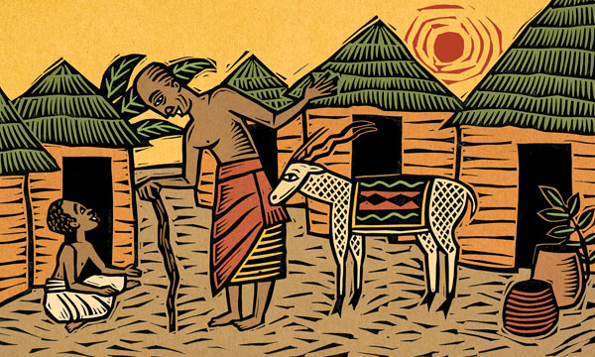
African storytelling explains the following three elements:
Why we tell stories?
What makes a story worth telling?
How are stories told?

Slide 28
The Power of African Stories

Slide 29
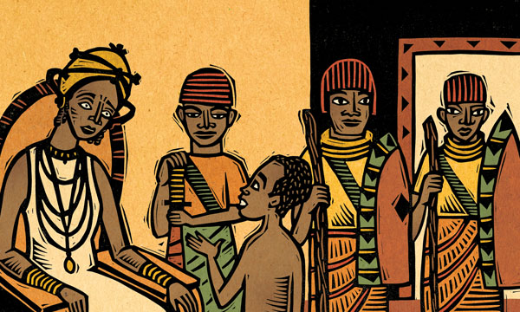
A story has many purposes:
It entertains, it informs, and it instructs.
The stories support and reinforce the basic doctrines of a culture.
The storyteller would figure out and calculate what is right and wrong, courageous and cowardly, and turn it into a lively story.

Slide 30
Moral Lessons of African Stories

Slide 31
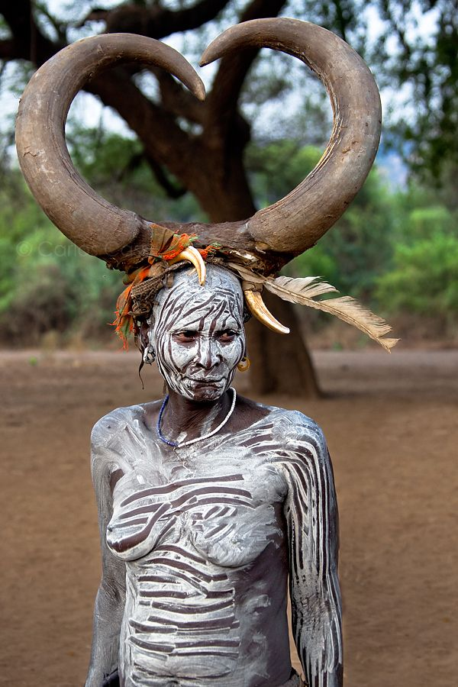
The main lesson of oral African stories is to teach and impact moral principles while also providing children with a sense of identity and belonging.
The young people will learn valuable life lessons.
African stories have been used to interpret the universe, resolve natural and physical phenomena, teach morals, uphold cultural values, pass on survival techniques, and praise God.
Trickster stories can be found in a variety of African cultures. Animals with human features are used in trickster stories to convey wisdom. Animals are also used in these stories to help people understand human nature and behavior. These stories are extremely important within the culture in which they are found. The animal trickster stories are meant to be both entertaining and educational. Animals are used in a variety of ways to depict human strengths and weaknesses.
(Yale National Initiative, 2008)

Slide 32
Proverbs and Parables in African Stories

Slide 33
The use of African proverbs and parables in oral storytelling demonstrates the people's collective wisdom as they express their meaning, feeling, thought, and expression structures.
This is critical when it comes to social, ethical, and cultural issues.
The story is a primary form of oral tradition, used primarily to convey culture, experience, and values, but the use of proverbs and parables would increase the weight and significance of a story. In oral societies, proverbs and parables are also used to transmit ancient knowledge, wisdom, profound feelings, and attitudes.
It would be nearly impossible to comprehend African literatures without first studying a specific culture and its traditions, from which African writers draw themes and values, narrative structures and plots, rhythms and styles, images and metaphors, and artistic and ethical principles.
The goal of using proverbs and parables is to achieve community harmony and wisdom while also exposing bad anti-social behavior.
(Tuwe, 2015)

Slide 34
Unit 3
The role of the Griot

Slide 35
Origin of Griot

Slide 36
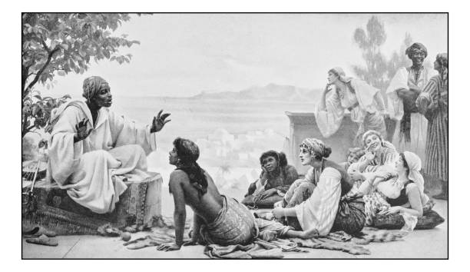
The word may derive from the French transliteration "guiriot" of the Portuguese word "criado", or the masculine singular term for "servant."
Griots are more predominant in the northern portions of West Africa.
Griots today live in many parts of West Africa and are present among the Mande peoples, Fulɓe, Hausa, Songhai, Tukulóor, Wolof, Serer, Mossi, Dagomba, Mauritanian Arabs, and many other smaller groups.
In African languages, griots are referred to by several names: jeli in northern Mande areas, jali in southern Mande areas, guewel in Wolof, kevel or kewel or okawul in Serer, gawlo 𞤺𞤢𞤱𞤤𞤮 in Pulaa (Fula), iggawen in Hassaniyan, arokin in Yoruba, and diari or gesere in Soninke.

Slide 37
What is a Griot

Slide 38
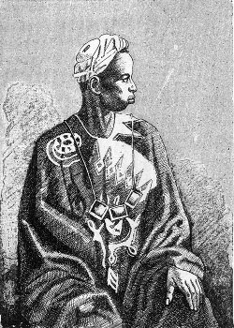
A West African historian, storyteller, praise singer, poet, or musician is known as a griot.
The griot is a repository of oral tradition and is frequently regarded as a leader due to their role as an advisor to royal figures.
Because of the former of these two functions, they are sometimes referred to as a bard.
Griots first appeared in the 13th century in Mali's Mande empire. For centuries, they have told and retold the empire's history, preserving its stories and traditions.
Despite their reputation as praise singers, griots may use their vocal prowess for gossip, satire, and political commentary. Griots can be found in many parts of West Africa today, and they belong to a variety of ethnic groups.
Griots are an endogamous caste, which means that most of them only marry other griots. They pass down the storytelling tradition from generation to generation. Each aristocratic griot family was accompanied by a higher-ranking family of warrior kings or emperors. No griot can exist without a king, and no king can exist without a griot. The king, on the other hand, can lend his griot to another king. Most villages also had a griot who told stories about births, deaths, marriages, battles, hunts, affairs, and other events.
(All Good Tales, 2018)

Slide 39
Griots and Music

Slide 40
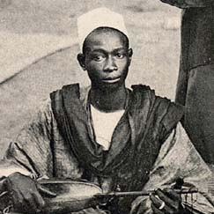
Griots are often skilled instrumentalists in addition to being singers and social commentators.
The kora, the khalam (or xalam), the goje (or n'ko in Mandinka), the balafon, the junjung, and the ngoni are among their instruments.
The kora is a lute-like instrument with a long neck and 21 strings. The xalam is a kora variant that typically has fewer than five strings. Both have gourd bodies that serve as a resonator. The ngoni, which has five or six strings, is also like these two instruments. The balafon is a type of wooden xylophone, whereas the goje is a stringed instrument played with a bow, like a fiddle.
The Encyclopaedia Britannica says: "Plucked lutes from West Africa, such as the konting, khalam, and nkoni (noticed by Ibn Baah in 1353), may have originated in ancient Egypt. The khalam is thought to be the banjo's ancestor. The ramkie of South Africa is another long-necked lute."

Slide 41
The role of the Griots

Slide 42
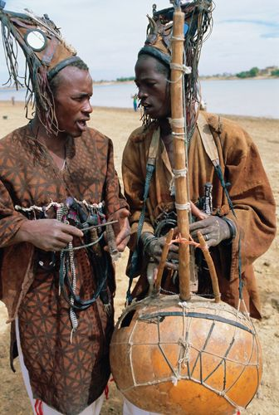
Griots play an important role in the preservation of a people's history, especially centuries ago when technology was not as advanced as it is now, and a whole lineage and history of people could have been forgotten otherwise.
This is especially true for communities where no one has ever learned to write or read.
Although they were once known as village advisors and diplomats who were called upon to intervene during disputes, this role has now diminished somewhat and their appeal as entertainers is more widespread.

Slide 44
Conclusions
Storytelling is a communal participatory experience-
The style and structure of the story illustrates its importance and significance
The use of proverbs and parables would enhance weight and significance of storytelling. Proverbs and parables are a means of transmitting ancient knowledge, wisdom, profound feelings, and attitudes in oral societies
The stories support and reinforce the basic doctrines of people’s culture. Storytelling is a powerful tool.
The main lesson behind oral African stories is to teach and impact principles of morality and provide youngsters with a sense of identity and belonging
African storytelling is a powerful pedagogical tool for communicating knowledge and wisdom. Storytelling is far from being a mere source of entertainment, the story helps to sharpen the people's creativity and imagination, to shape their behavior, to train their intellect and to regulate their emotions.

Slide 45
References:
‘Storytelling Traditions across the World: West Africa’. All Good Tales, 8 Nov. 2018, https://allgoodtales.com/storytelling-traditions-across-world-west-africa/.
Tuwe, Kudakwashe. The African Oral Tradition Paradigm of Storytelling as a Methodological Framework: Employment Experiences for African Communities in New Zealand. 2015, p. 18.
What Is a Griot and Why Are They Important? https://theculturetrip.com/africa/mali/articles/what-is-a-griot-and-why-are-they-important/. Accessed 20 June 2022.
Y, Dr. ‘The Griot, the Preserver of African Traditions’. African Heritage, 21 May 2018, https://afrolegends.com/2018/05/21/the-griot-the-preserver-of-african-traditions/.
- Yale National Initiative. https://teachers.yale.edu/curriculum/units/2009/1. Accessed 20 June 2022.

Slide 46
"The European Commission's support for the production of this publication does not constitute an endorsement of the contents, which reflect the views only of the authors, and the Commission cannot be held responsible for any use which may be made of the information contained therein.” Project Number: 2020-1-FR01-KA227-ADU-095130

