Slide 1
Modulo 2 – Io come Storyteller

Slide 2
Modulo 2: Io come Storyteller

Slide 3
Io come Storyteller
Risultati dell’apprendimento

Slide 4
Al completamento con successo di questo modulo, i partecipanti adulti saranno in grado di | Conoscenze | Skills | Attitudini
 | Conoscenze di base su come formare la struttura di una storia | Discuti su come creare storie | Raccontare storie per promuovere la comprensione e la comunicazione interculturale
 | Conoscenza di base dei diversi stili narrativi e come trovare la propria voce come narratore | Saper stimolare emozioni, drammi e anticipazioni attraverso la narrazione | Valutare come stimolare emozioni, drammi, anticipazioni attraverso la narrazione
 | Conoscenze di base su come sviluppare un buon carattere | Identificare i principi, gli elementi e le tecniche della narrazione e come integrarli nelle storie | Apprezzare l'impatto culturale che hanno le storie
 | Conoscenza pratica dei diversi formati delle storie – narratore in prima persona o narratore in terza persona | Esplorare l'arte e le tecniche della narrazione | Apprezzare il ruolo della persona narrante e che ha nella conservazione delle tradizioni

Slide 5
Al completamento con successo di questo modulo, i partecipanti adulti saranno in grado di | Conoscenza | Skills | Attitudini
 | Conoscenza pratica di come utilizzare i tempi verbali nella narrazione- passato, presente e futuro | Riconoscere come la narrazione può condividere un senso di storia, valori e tradizioni
 | Conoscenza pratica delle abilità oratorie necessarie per la narrazione - controllo del tono, il volume del tono, il linguaggio del corpo, ecc. | Distinguere tra i diversi tipi di storie, il ruolo che svolgono nella tradizione orale
 | Conoscenza pratica di come utilizzare il tuo corpo nella narrazione – il ruolo del movimento, del gesto e della danza nella narrazione | Dimostrare le 4P della narrazione: persone, luogo, trama, scopo
 | Conoscenza pratica di come essere un narratore sicuro, chiaro e conciso
 | Conoscenza pratica di come creare storie
 | Conoscenza teorica dei diversi elementi che concorrono allo storytelling

Slide 6
Unità 1: Come costruire uno Storytelling

Slide 7
Il significato dello storytelling

Slide 8
“La narrazione è il processo di tessitura del linguaggio in una narrazione concreta, con lo scopo di creare esperienze ricche e credibili".
Source: says, W. L. R. U. 11/15-B. S. S. (2021, September 14). Capturing the Art of Storytelling: Techniques & Tips. Writers.com. https://writers.com/the-art-of-storytelling
‌
Notes:
Telling a story can mean many things, it just depends on the person who tells the story and the receiver. The people who tell stories convey facts, insert a context, a plot and the characters themselves. Their goal, when tell the story is to gain the attention of the listener. The listener has to feel interested and involved in the story, as if he/she also lived the story in the first person.
One of the secrets of storytellers is the use of metaphors to talk about human experiences. The experiences are different for all people (even if they all went through the same experience, in the same place, at the same time, with the same people, etc.), so each one tells the story in their own way. And, this is the beauty of storytelling.

Slide 9
Come raccontare una storia?
Notes:
The structure of a narrative is its own organization. That is, how history organizes itself and at the same time develops. Mostly, the organizational structure of history has a beginning, middle and end. Narratives, as a rule, are engaging and pleasant.

Slide 10
Esistono 5 tipi di tecniche narrative:
Lineare | Gli eventi seguono una linea cronologica.
Non lineare | Gli eventi non seguono una linea cronologica. Possono confondere il pubblico all'inizio ma man mano che la storia progredisce le scene hanno un senso.
Parallelo | Come suggerisce il nome, la trama avviene simultaneamente / parallelamente ad altre storie.
Circolare | In questa narrazione, la storia finisce com’è iniziata. Man mano che gli eventi passano, la storia torna all'inizio.
Interattivo | La narrazione segue le scelte del pubblico. La persona sceglie la direzione che vuol far prendere alla storia.
Notes:
There are 5 types of narrative techniques. These vary according to the events and their sequence. The plot structure of a story can be:
- Linear: events follow a chronological line.
- Nonlinear: events do not follow a chronological line. They can therefore confuse the audience at first, but as the story progresses the scenes eventually make sense.
- Parallel: as the name implies, the plot happens simultaneously / parallel with other stories.
- Circular: in this narrative, the story ends as it began. As events go by, the story goes back to the beginning.
- Interactive: the narrative follows the choices of the audience. The person chooses the direction he wants to take to history.

Slide 11
Cose da considerare quando si crea una narrazione

Slide 12
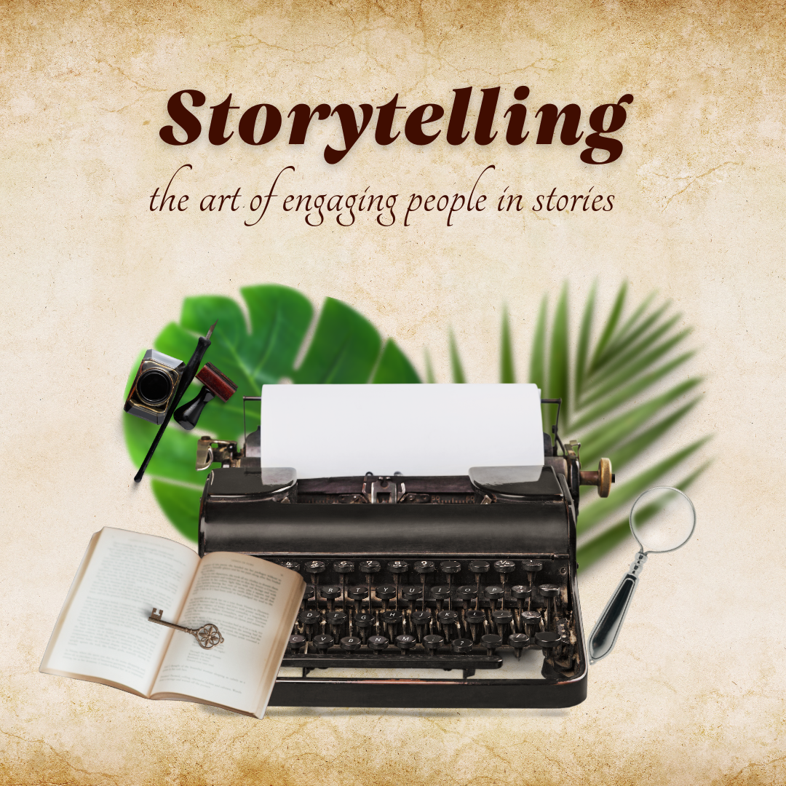
Chi è il personaggio principale della storia?
Qual è la sua posizione nello sviluppo della storia?
Notes:
1 - To tell a story, the first step is to capture the audience's attention. The beginning of the story has to be like the cover and the title of a book, without reading, you are already interested in knowing more.
For a storyteller it is important to bring the characters to life.
The characters are at the centre of the story, they must create empathy and generate emotions in the audience, from laughing to crying.
Throughout the story, the audience emerges in misfortunes or luck, along with the storyteller.
2 - The storyteller should face the role of the main character. By telling your own story the audience shows interest more easily. Especially, when the story is about self-overcoming, challenges and / or adversities.
By taking the lead role in your own story, you know it better than anyone else, you can create suspense during the events and in the end conclude with a situation that creates climax. In this way, the audience can be surprised by the outcome and your character will become unforgettable at the end.

Slide 13
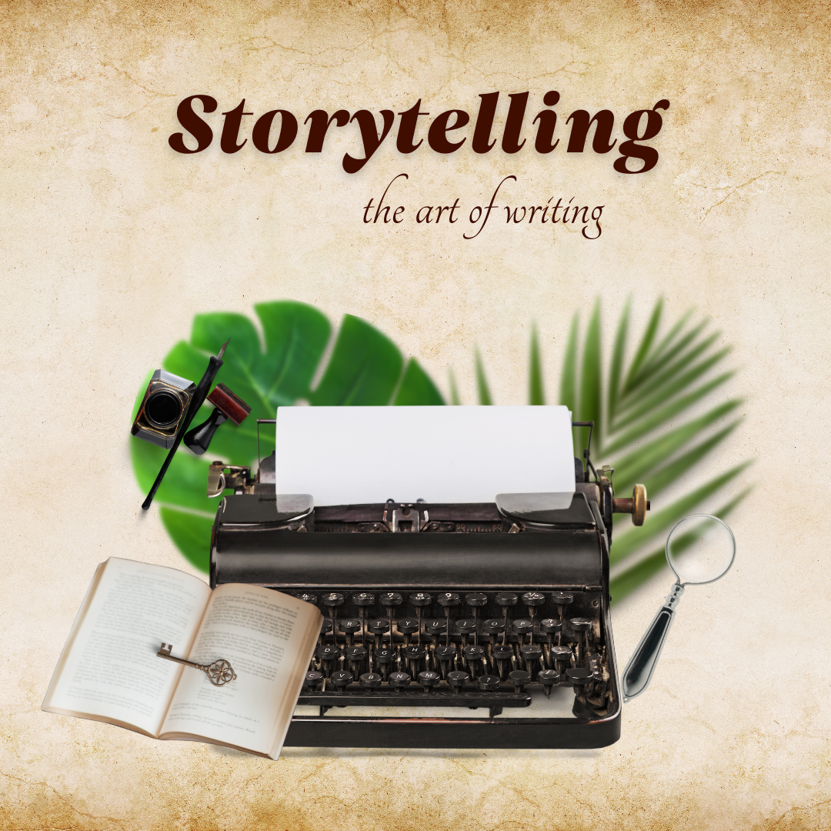
Qual è l'impatto di quando la storia viene raccontata nel passato, nel presente e nel futuro?
Qual è il formato della storia? Il narratore racconta la storia in 1a o in 3a persona?
Notes:
3 - When the stories are told in the present, urge the audience to think about the simplicity and the immediate of the action. The storyteller transports the audience into the experience at the moment.
When the story is told in the past there is an introduction of various moods. That is, the story is told in different scenarios and about various circumstances that remote to the past.
In the future, the storyteller usually describes plans or strategies. The storyteller makes an accurate, decisive, and responsible speech.
4 - When the story is told in the third person, it may mean that you have not actually experienced the events, that is, you are only reporting the story of someone else, instead of yours. Stories told in the third person can become less interesting and less captivating to the audience.

Slide 14
Abilità oratorie necessarie per la narrazione

Slide 15
In un discorso pubblico, la postura del corpo influenza la trasparenza e la qualità del messaggio. Le abilità oratorie sono raggiungibili da qualsiasi persona perché possono essere acquisite.
Notes:
Eye contact: makes the connection between the speaker and the audience. It conveys an image of trust and credibility.
Gestures: convey confidence and the feeling of tranquillity when speaking.
Facial expressions: it is the most widespread form of non-verbal communication. Happiness, sadness, fear and anger are common all over the world.
Paralinguistics: it is associated with the tone of voice. The same words spoken in different tones of voice (stronger, hesitant, etc.) are interpreted differently.
Touch: it is a common behaviour. It can mean respect, trust, distance.
Proxemics: personal space reflects the signs of proximity or social detachment between people.

Slide 16
Unità 2: La tua storia

Slide 17
Le 4P della narrazione
Notes:
There are 4 fundamental pillars to build a strong and impactful narrative.
These 4P’s Of Story Telling have to be cohesive and clear when it comes to telling the story. Well structured and together will create a greater impact and engagement of the audience.

Slide 18
People
Persone
Notes:
People in the storytelling are the main role.
Stories are told from people to people, and only in this way does it make sense to tell stories.
In addition, the story must captivate, through emotions, connecting with the audience emotionally is an asset to achieve success.

Slide 19
Place
Luogo
Notes:
The place where the story is set is as relevant as the stage where the story is told.
For the public to better understand the story it is important to describe the physical space, refer the thought of the audience in the exact place so that the story has a more authentic character.

Slide 20
Purpose
Scopo
Notes:
The purpose is nothing more than the meaning of history.
The stories, in addition to being felt by the storyteller, must convey feelings to the audience that listens to him/her.
Stories with a sense, purpose and objective are more believable and empathetic.

Slide 21
Plot
Trama
Notes:
The plot is the structure of the narrative.
There are some types of plots, for example tragedy, comedy, heroes, overcoming, etc.
The plot consists , majority, in 5 elements: exposure, rising action, climax, falling action and denouement. (You can find more information here: https://www.authorlearningcenter.com/writing/fiction/w/plot-planning/7309/5-elements-of-plot-and-how-to-use-them-to-build-your-novel)

Slide 22
Unità 3: Il potere dello Storytelling
Notes:
When you hear a story, you have the opportunity to learn from the experience of the person who is telling you the story.
A good storyteller can change the way you see, evaluate, and even think about the values and opinions that were previously formed on the subject.
According to Uri Hasson, professor of psychology and neuroscience at Princeton University, when listening to a story several areas of the brain become illuminated, not only those that networks involved in language processing, but also other neural circuits.
When more exciting parts appear in the story, according to the same author, the part of the brain that processes sounds also becomes alert and activated. This means that as you listen to a story, your brainwaves synchronize with the storyteller.

Slide 23
Testa, cuore e presenza
Notes:
The stories that remain are impactful, true and realistic.
For the story be remain in the memory of those who hear it, it must come from the heart, structured in the mind and transmit presence.

Slide 24
Notes:
Storytelling is not a process or a specific technique, but rather an art. The art of storytelling . This requires creativity, oratory skills and a lot of practice.
The storyteller turns abstract concepts into solid images, mystifies complex concepts into simple and concrete phrases.
The storyteller has the ability to reach people's hearts and minds because stories beyond bringing people and also brings communities and cultures together.

Slide 25
Conosci il tuo pubblico

Slide 26
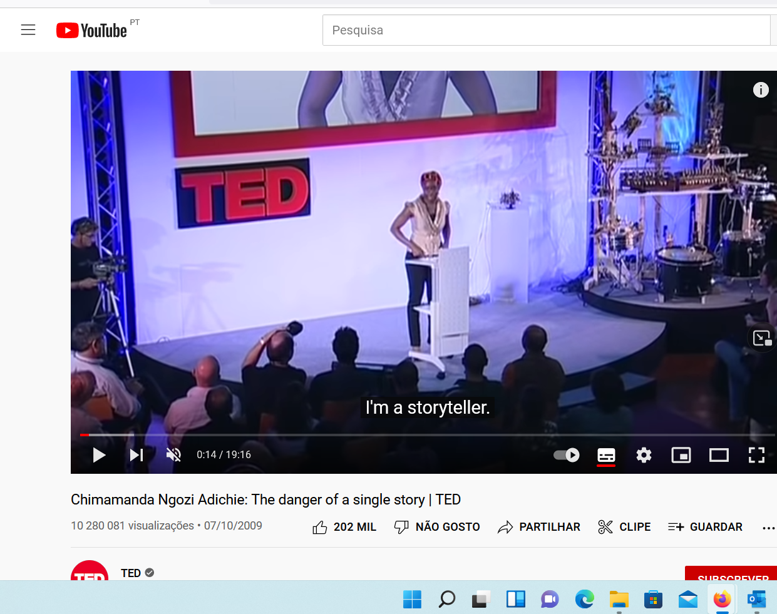
Pubblico
Notes:
The first step is to search for your target audience. Who do you want to tell your story to?
There is always something in common among the audience. That's what you should focus on, finding data and things in common among the people who will listen to you.
After discovering and defining the data in common you can create a profile (with name, demographic details, etc.). This will make it easier to identify your audience and write your story.
For example, if the speech is at a university, at the end of the year, in principle your audience will be young adults between the ages of 20 and 30. It is on this type of information that speech can focus.

Slide 27
Evita i cliché comuni della trama
Notes:
The problem with plot cliches is that they don't mention genuine details.
Therefore, avoid telling stories that are not yours, do not belong to you, because the story will lose its veracity and authenticity.
Avoid talking about sectionalist topics. Even if these are true. If you choose to do so, introduce your version of the theme into the story.

Slide 28
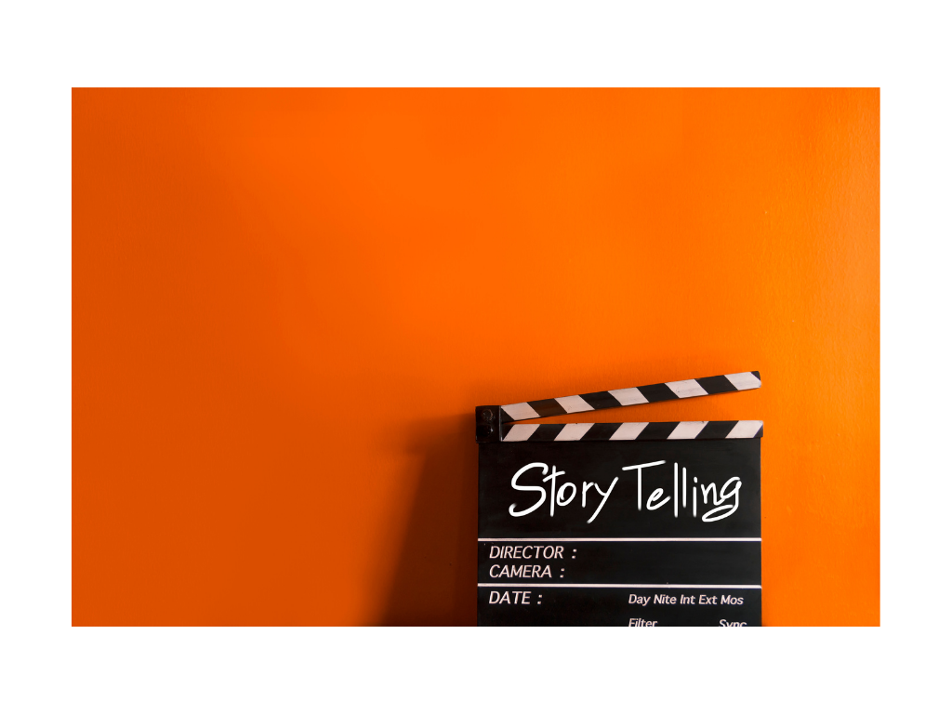
Cliché comuni della trama: Amori impossibili / proibiti Lieto fine Incontri / Amore inaspettato Mistero Tabù

Slide 29
Personale
Semplice
Le belle storie sono...
Memorabile
Coinvolgente e divertente

Slide 30
Domande?

Slide 31
"The European Commission's support for the production of this publication does not constitute an endorsement of the contents, which reflect the views only of the authors, and the Commission cannot be held responsible for any use which may be made of the information contained therein.” Project Number: 2020-1-FR01-KA227-ADU-095130

